Slide 1
Aviation Weather:
Tools of the Trade
David G. Bieger
Meteorologist in Charge
Center Weather Service Unit

Slide 2
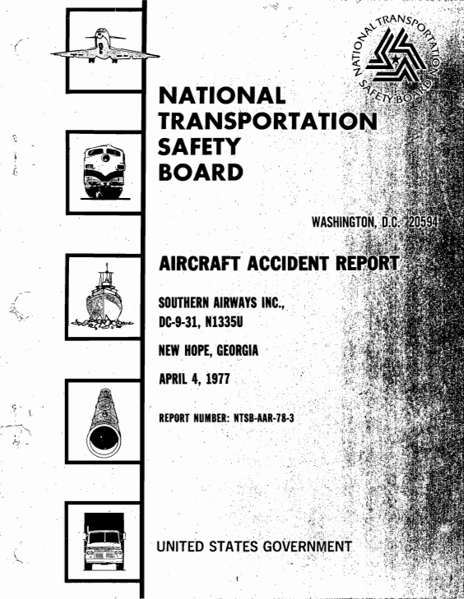
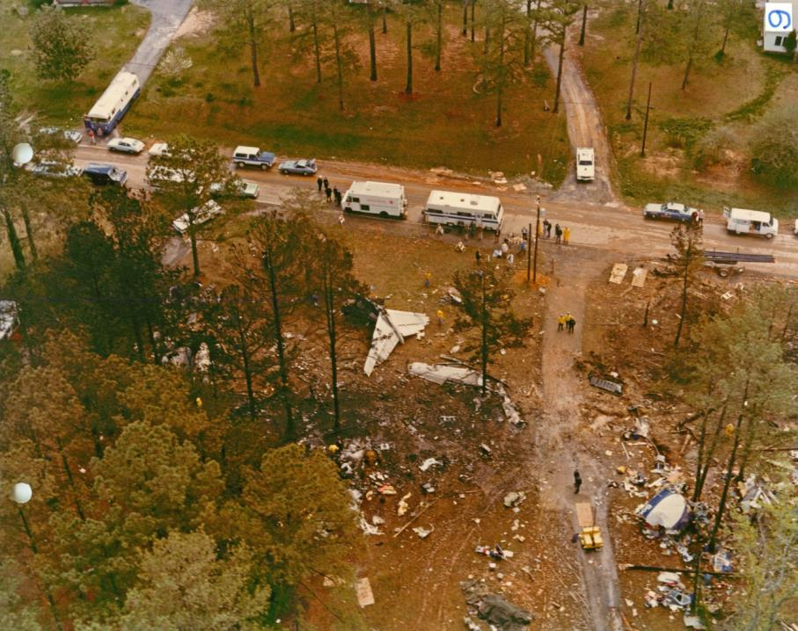
Why We Are Here
The result of Southern Airways Flight 242 crash in New Hope, GA on April 4, 1977…72 souls lost
Total loss of thrust from both engines due to damage from ingest of water/hail while penetrating an area of severe thunderstorms
CWSUs established by FAA in 1978 as a result of NTSB recommendation A-77-068 to formulate procedures for the timely dissemination of all available severe weather information by controllers
Source: NTSB
“…limitations in the Federal Aviation Administration’s air traffic control system which precluded the timely dissemination of real-time hazardous weather information to the flight crew.” – NTSB-AAR-78-3, Jan 1978

Slide 3
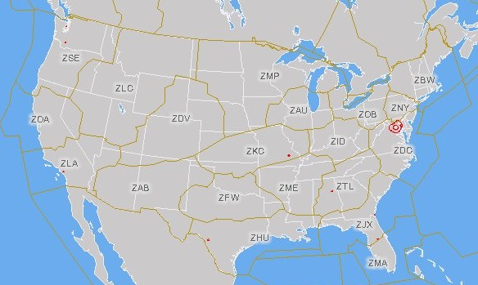
Why We Are Here
Source: FAA
NWS Meteorologists provide IDSS at all 21 ARTCCs
as well as the ATCSCC (NAM)

Slide 4
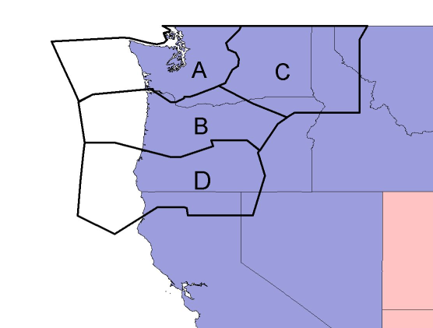

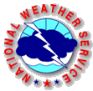
Seattle CWSU Forecast Area
(ZSE ARTCC control areas shown in black)
All, or part, of six western states and adjacent offshore waters
More than 300,000 square miles
A range of climatic zones from marine, modified marine, arid, semi-arid, alpine and rain forest
●
SEW
●
OTX
●
MSO
●
●
PDT
PQR
●
Internal WFO
SEW
PQR
MFR
EKA
OTX
PDT
First Tier WFO
MSO
BOI
LKN
REV
STO
MTR
BOI
●
MFR
●
●
EKA
LKN
●
●
REV
STO
MTR
●
Source: NWS
NOAA/NWS Seattle Center Weather Service Unit (ZSE)

Slide 5
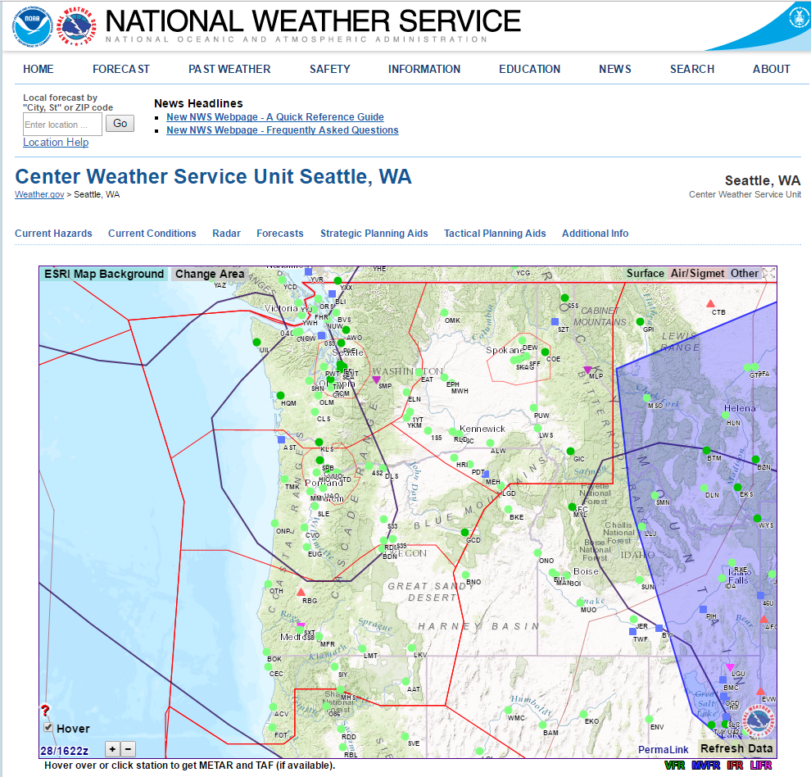
Seattle CWSU
www.weather.gov/zse/
NOAA/NWS Seattle Center Weather Service Unit (ZSE)

Slide 6
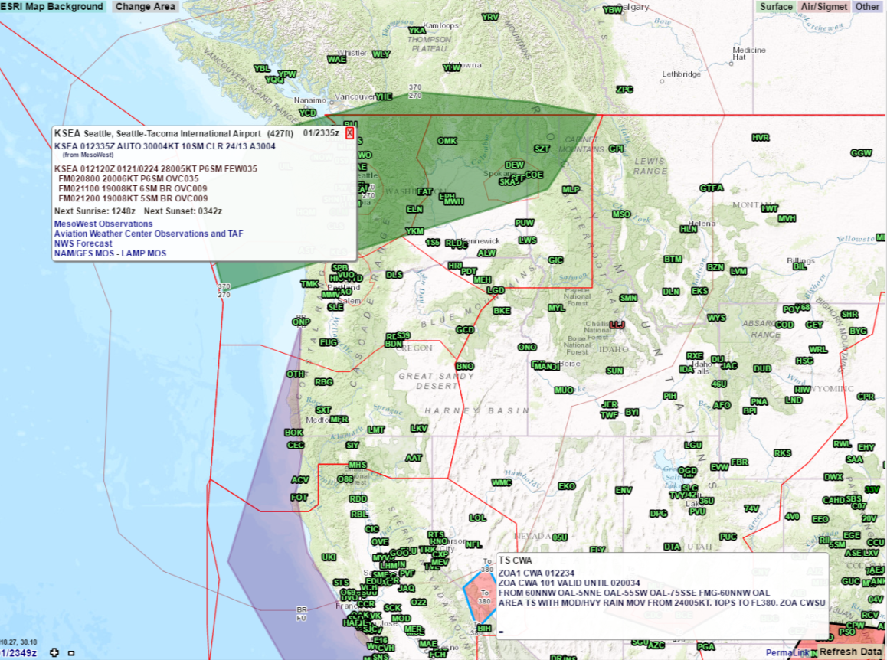
Seattle CWSU
www.weather.gov/zse/
Change Background and Domain
Overlay Multiple Data Layers
Create a PermaLink
NOAA/NWS Seattle Center Weather Service Unit (ZSE)

Slide 7
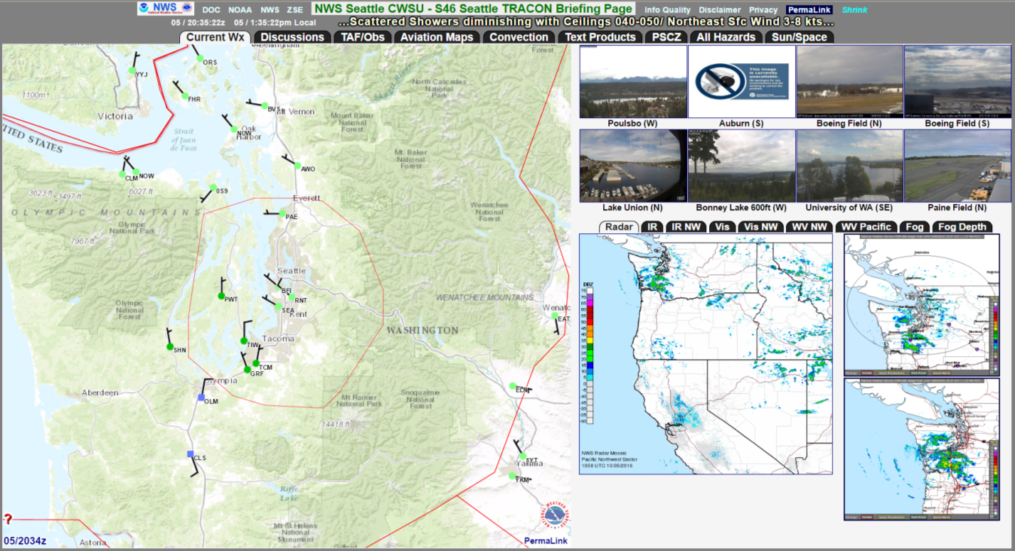
Pilot Weather Briefing Pages
www.weather.gov/zse/ZSETRACONBriefing?S46
NOAA/NWS Seattle Center Weather Service Unit (ZSE)

Slide 8
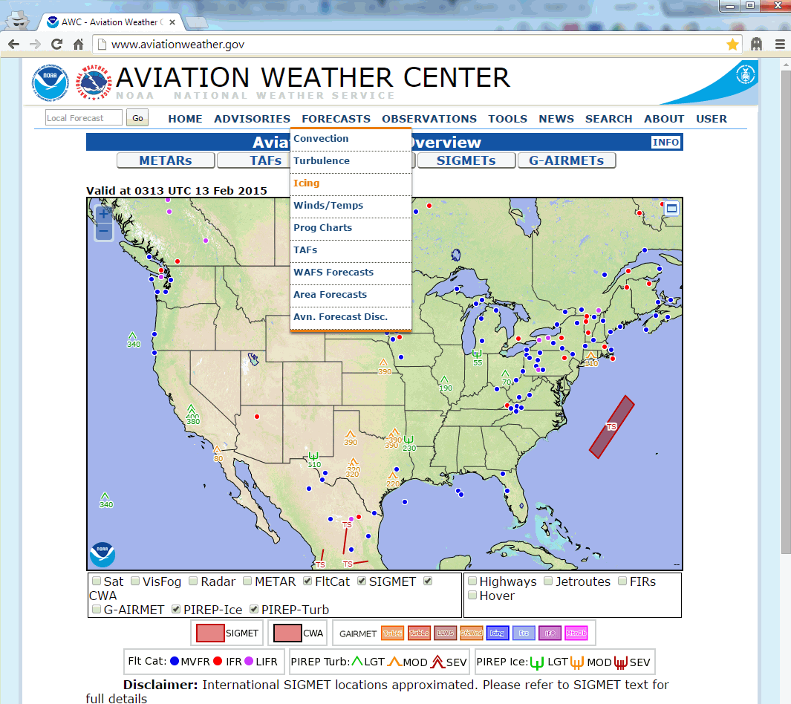
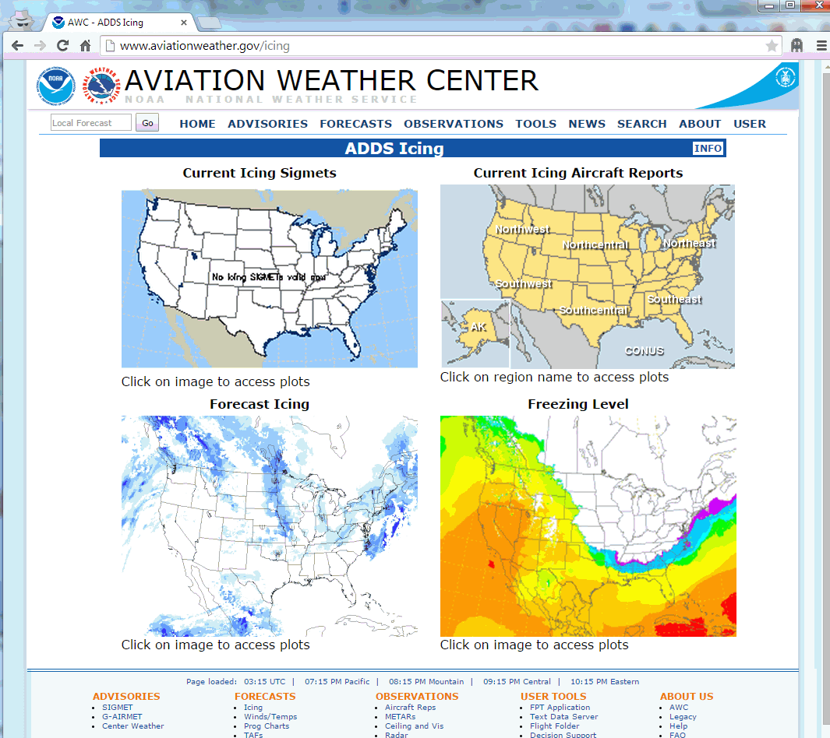
Aviation Weather Center
https://www.aviationweather.gov
NOAA/NWS Seattle Center Weather Service Unit (ZSE)

Slide 9
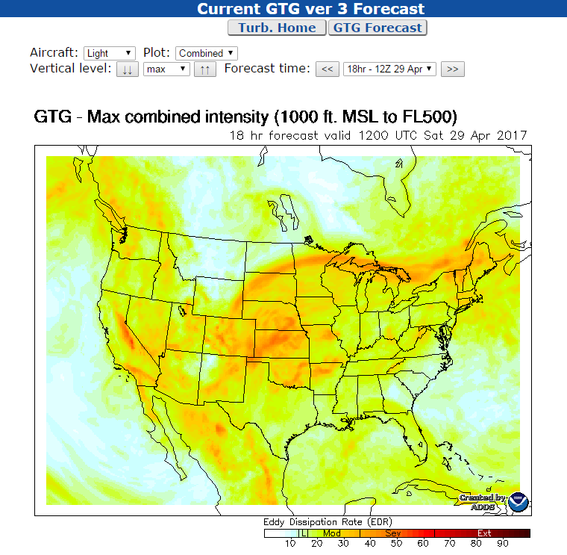
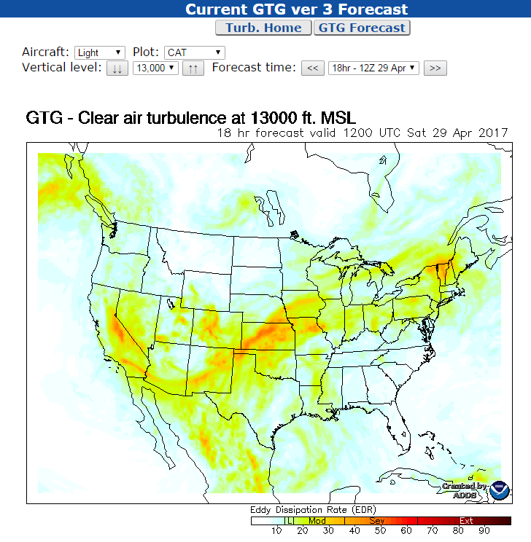
Aviation Weather Center
www.aviationweather.gov/turbulence/gtg
Updated Hourly / 18 Hour Forecasts / From 1,000 Ft to FL450
NOAA/NWS Seattle Center Weather Service Unit (ZSE)

Slide 10
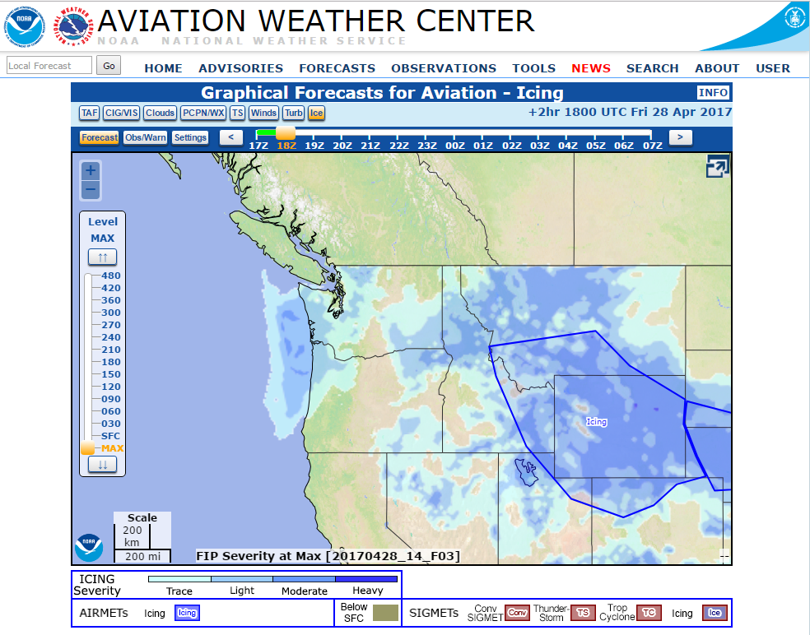
Aviation Weather Center
www.aviationweather.gov/gfa
*
NOAA/NWS Seattle Center Weather Service Unit (ZSE)

Slide 11
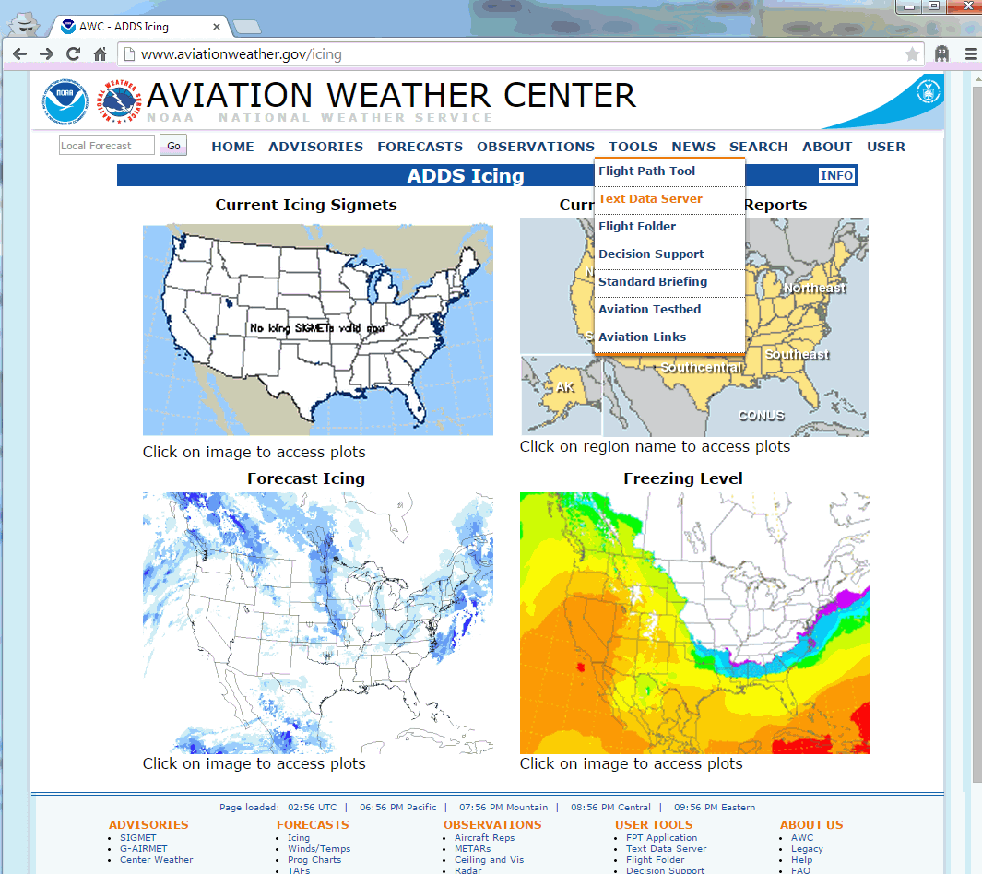
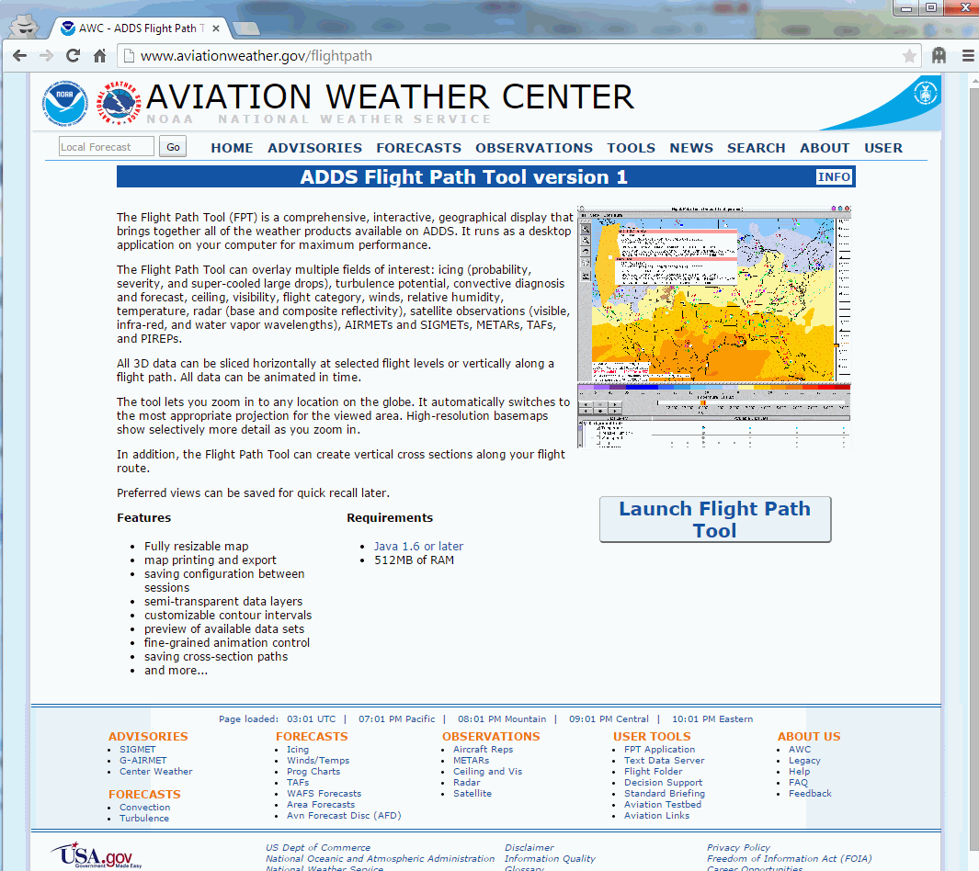
Aviation Weather Center
www.aviationweather.gov/flightpath
NOAA/NWS Seattle Center Weather Service Unit (ZSE)

Slide 12
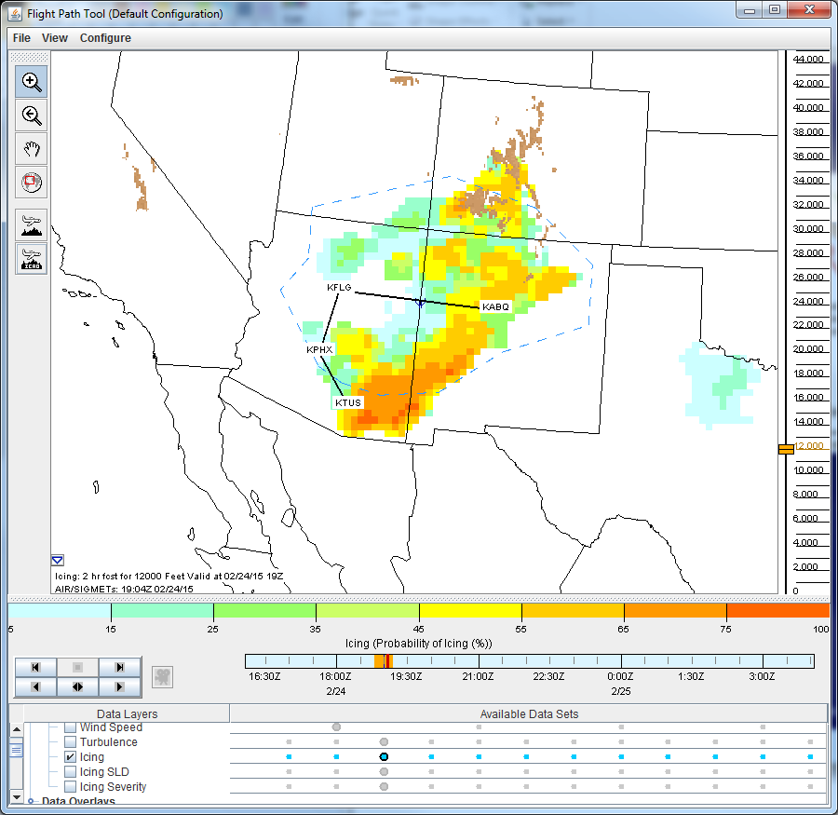
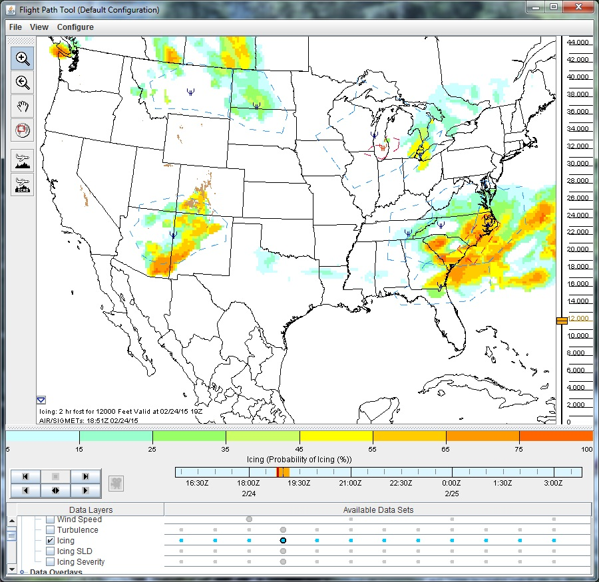
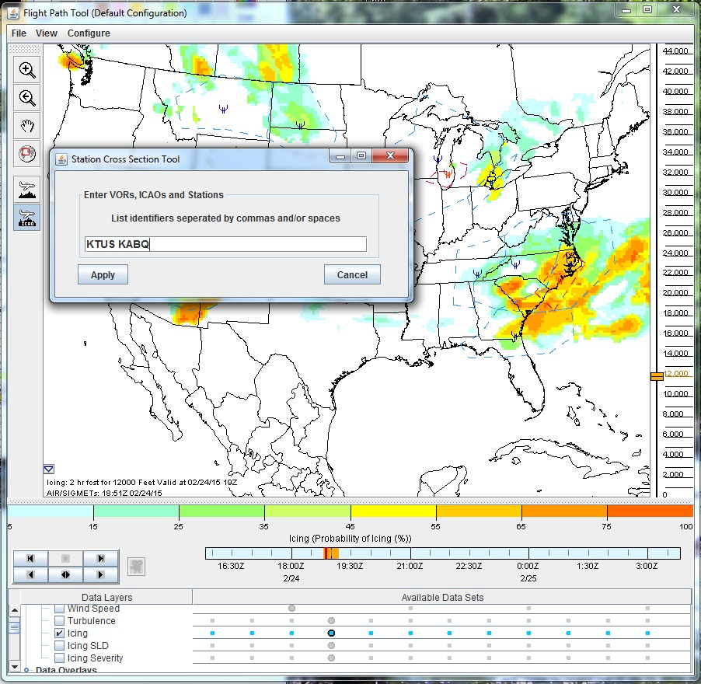
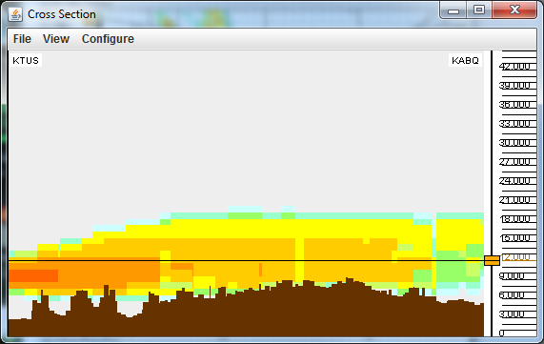
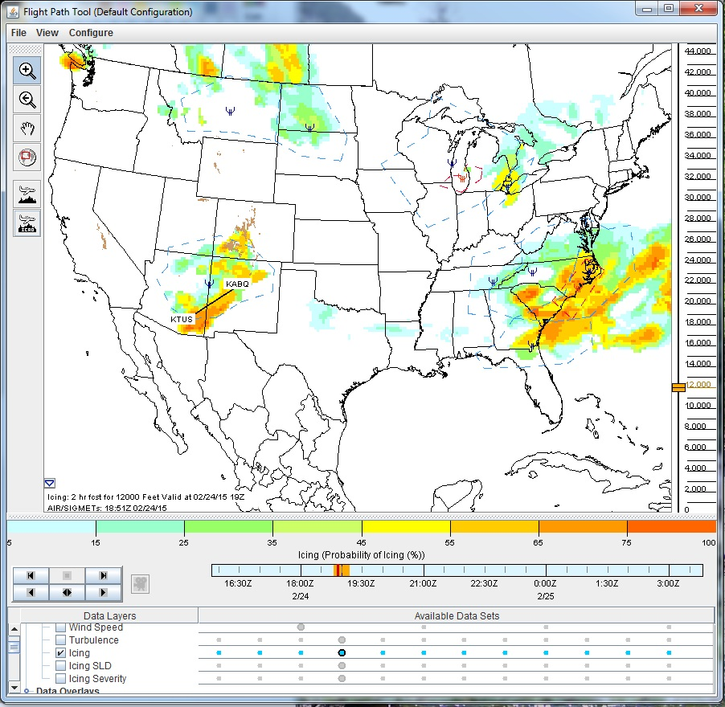
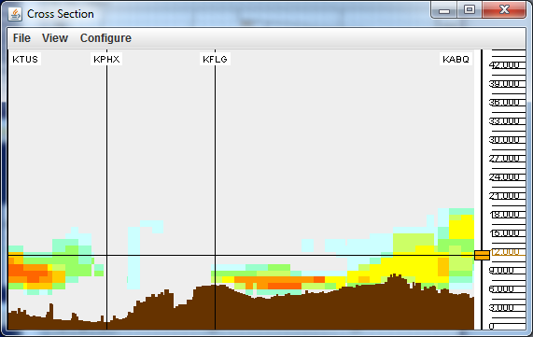
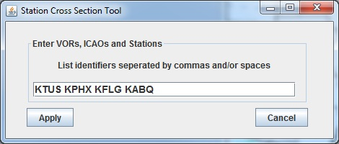
Aviation Weather Center
www.aviationweather.gov/flightpath
Example over AZ-NM from Tuesday, 24 February 2015.
The flight tool can help you avoid expected hazard areas along your route.
*
NOAA/NWS Seattle Center Weather Service Unit (ZSE)

Slide 13
Aviation Weather Center
www.aviationweather.gov/flightpath
Requires Java
  Therefore smartphones and most tablets will not work
Resizable map
Customizable contour intervals
NOAA/NWS Seattle Center Weather Service Unit (ZSE)

Slide 14
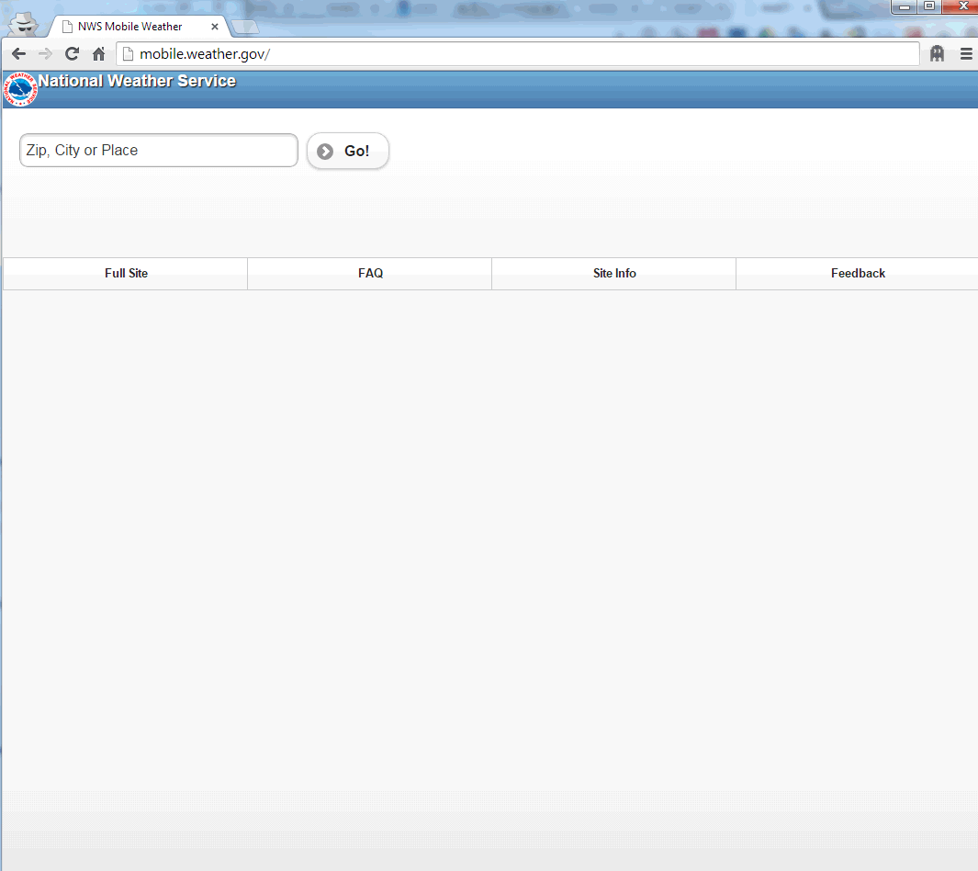
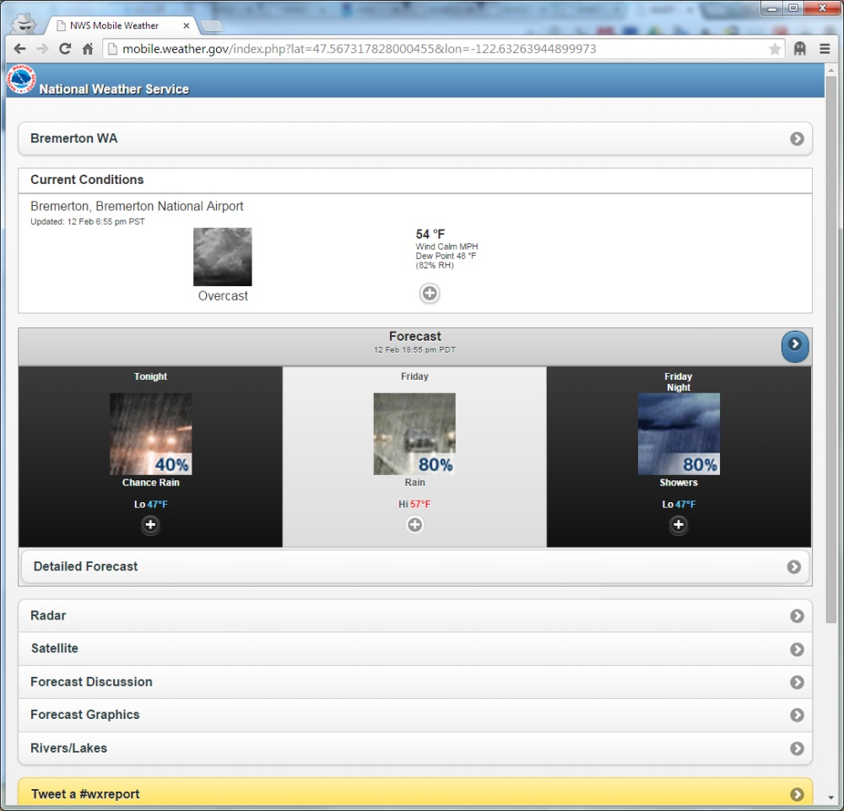
NWS Mobile Weather
mobile.weather.gov
*
NOAA/NWS Seattle Center Weather Service Unit (ZSE)

Slide 15
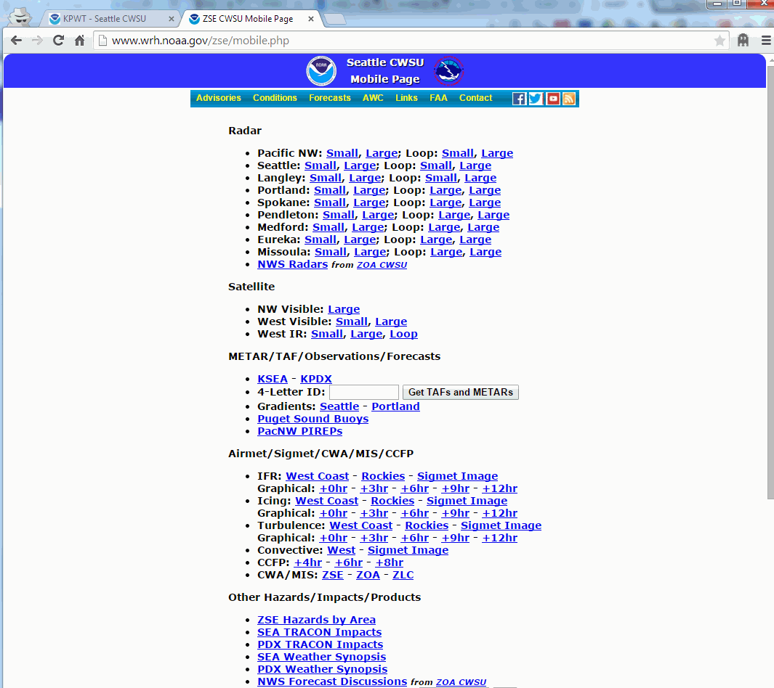
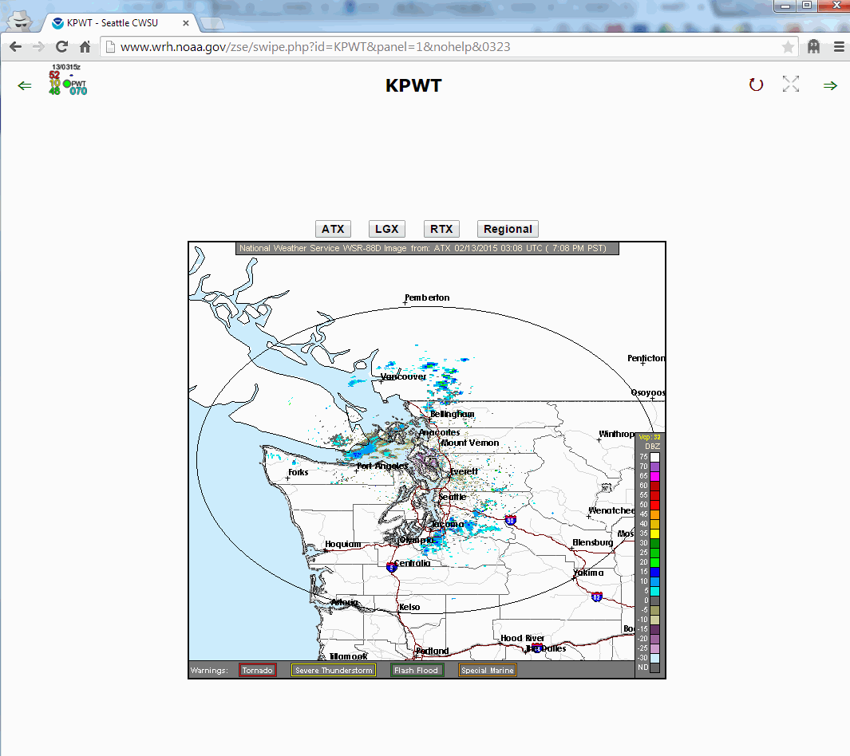
Seattle CWSU
www.wrh.noaa.gov/zse/mobile.php
www.wrh.noaa.gov/zse/swipe.php
*
NOAA/NWS Seattle Center Weather Service Unit (ZSE)

Slide 16
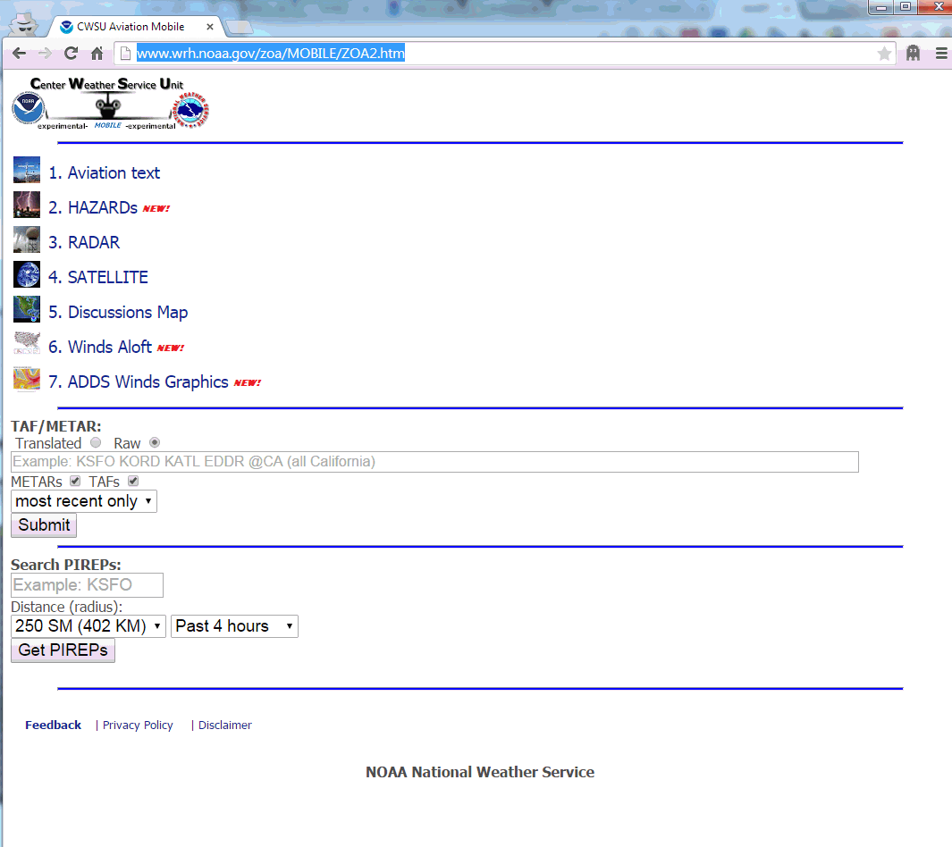
Oakland CWSU
www.wrh.noaa.gov/zoa/MOBILE/ZOA2.htm
*
NOAA/NWS Seattle Center Weather Service Unit (ZSE)

Slide 17


Social Media Activities
Headlines used on main ZSE webpage
Red banner used for “big” events
ZSE issues Weather Stories
ZSE posts to Facebook
ZSE posts to Twitter
Providing Extended Decision Support Services to the
Pacific Northwest Aviation Community
NOAA/NWS Seattle Center Weather Service Unit (ZSE)

Slide 18
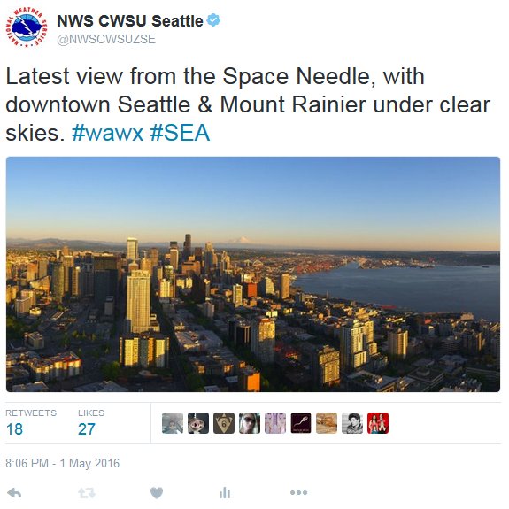
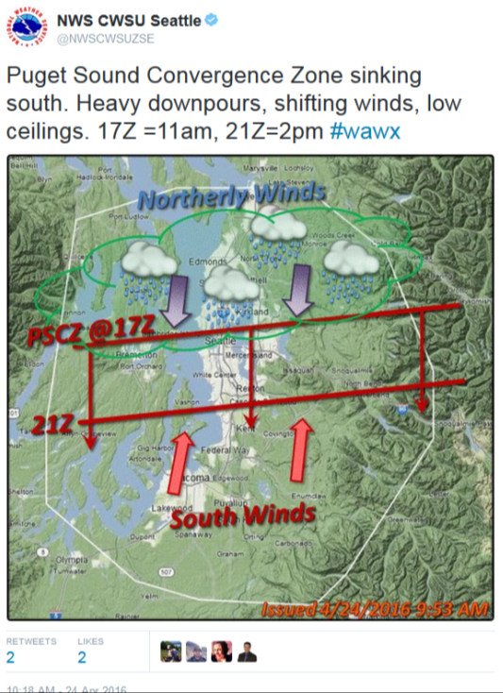
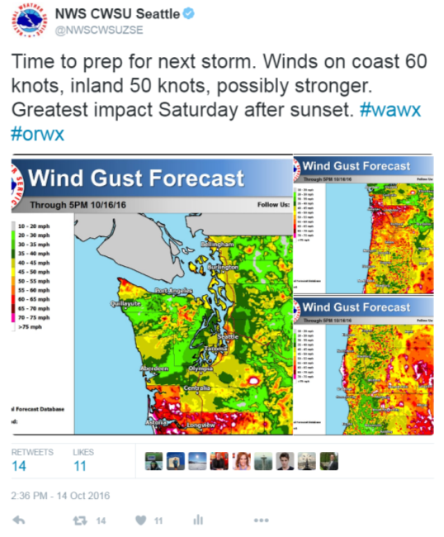
IDSS Meets Social Science
NOAA/NWS Seattle Center Weather Service Unit (ZSE)

Slide 19

Questions?
NOAA/NWS Seattle Center Weather Service Unit (ZSE)

Slide 20
Useful Links For
Pilot Weather Briefing
http://www.weather.gov/seattle - Seattle Weather Forecast Office home page; includes local “point-and-click” forecast map, local area hazard warnings and advisories, climatology outlooks, and tailored aviation weather page
http://www.weather.gov/zse - Seattle CWSU home page; includes customizable map where you can overlay PIREPs, AIRMETs, SIGMETs, CWAs, highest freezing level, radar, satellite, etc.
http://www.weather.gov/zse/ZSETRACONBriefing?S46 - Seattle TRACON (S46) briefing page; includes multiple tabs for TAFs, METARs, forecast discussions, hazard maps, surface and winds aloft forecasts, text model data (MOS), etc.
https://aviationweather.gov - Aviation Weather Center (AWC) home page; includes aviation advisories, hazard forecasts, observations and customizable maps, as well as tools such as Graphical Forecasts for Aviation, Flight Path Tool, etc.
https://aviationweather.gov/gfa - AWC Graphical Forecasts for Aviation; replaces legacy text area forecast (FA) and offers observation and forecast overlays for ceiling, visibility, cloud layers, icing, turbulence, thunderstorms, etc.
https://aviationweather.gov/flightpath - AWC Flight Path tool (requires Java) can help determine the best path to avoid icing and turbulence. The tool is customizable (both zooming into areas and displaying a specific path and altitude).
http://mobile.weather.gov - The NWS mobile page for basic local forecasts, radar, discussions, forecast graphics, etc.
http://www.wrh.noaa.gov/zse/mobile.php - Seattle CWSU mobile page includes Pacific NW links for radar, satellite, TAF/METARs, PIREPs, AIRMETs/SIGMETs, CWA/MIS, area hazards, other images, links to other NWS mobile pages
NOAA/NWS Seattle Center Weather Service Unit (ZSE)

Slide 21
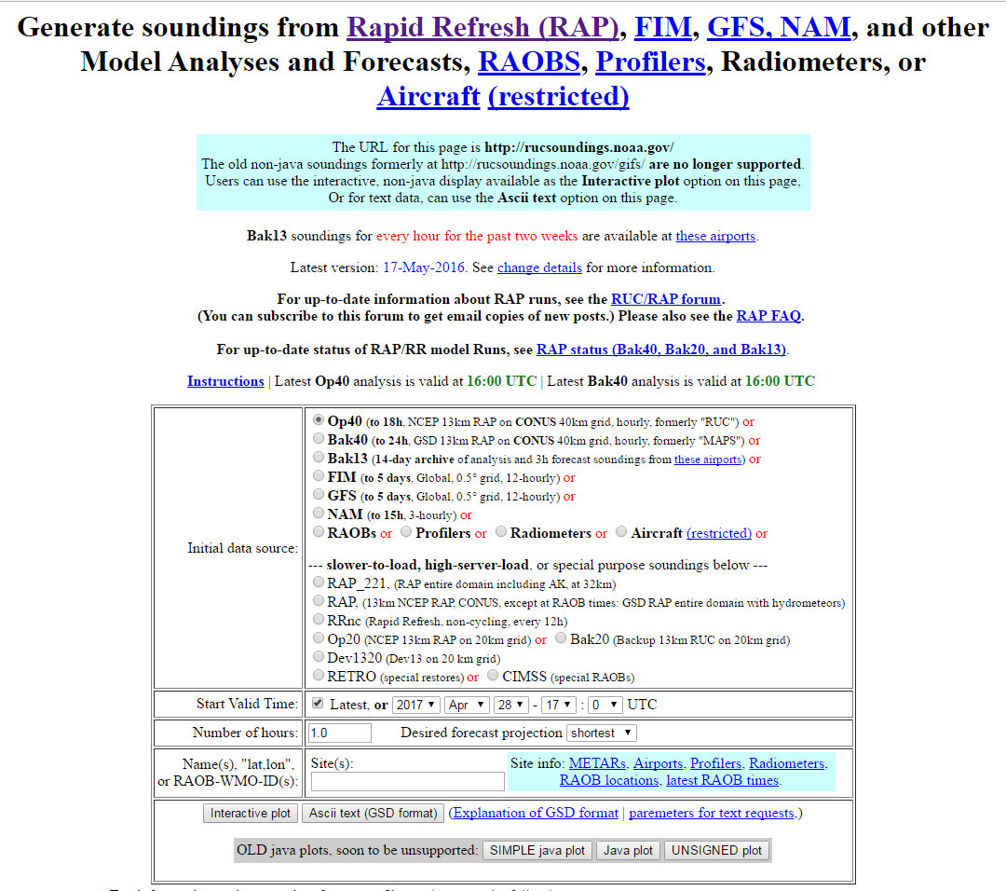
NWS RAP/RUC Analyses/Forecasts
https://rucsoundings.noaa.gov/
Red: Temperature (°C)
Blue: Dew Point Temp (°C)
Change forecast time
Altitude (ft)
Wind Speed (kt)
Fog/Clouds Likely
HQM had 2-3sm Visibility and
014-016 Ceiling Developing
NOAA/NWS Seattle Center Weather Service Unit (ZSE)

