Slide 1
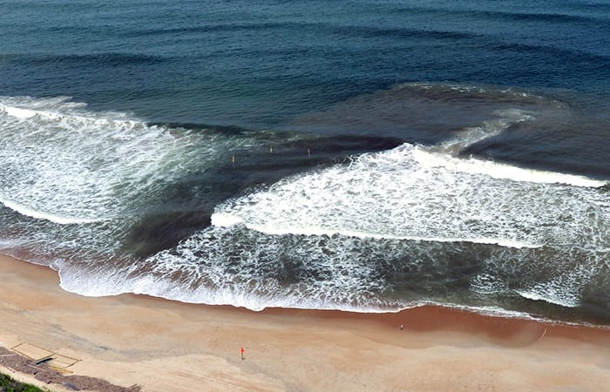




Rip Current Basics and Safety Information
Know Your Options!
Building a Weather-Ready Nation
Notes:
Introduction – Rip Current Basics and Safety Information
Rip currents kill more than 100 people each year off our nation’s coasts including the Great Lakes.
Rip currents are found at surf beaches, but they affect people from across the country, since hundreds of millions of people visit beaches every year.
Also, it is estimated that ¼ of rip current fatalities are bystanders who try to rescue others without proper training or equipment.
Let’s learn more about rip currents, and especially how to stay safe if you are caught in one or see someone in distress.

Slide 2




What is important to learn…
What are rip currents?
Why are they dangerous?
What are clues that a rip current may be present?
How do I know if I am caught in rip?
What can I do if I am caught in a rip?
How do I help someone else?
What are some other safety tips?
Photo: Galveston, TX Beach Patrol
Notes:
Objectives – What is important to learn…
This training includes: basic rip current information, why they are dangerous, how to spot them, what to do if caught in a rip, learning about your options if you see someone in a rip, and other beach safety tips.
For more information visit the United States Lifesaving Association and National Weather Service rip current web sites: www.usla.org/ripcurrents and www.ripcurrents.noaa.gov

Slide 3
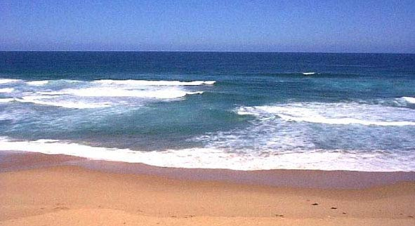
The most common beach hazard
Rips are channelized currents of water that flow back into the ocean from the shoreline
They typically form at breaks in sandbars, and near structures such as jetties & piers
Rips are commonly found on along all surf beaches, including Great Lakes beaches
Rip current
Photo: NOAA
Notes:
The most common beach hazard
Rips are the most common hazard found at a surf beach.
They are channelized currents of water that flow back into the ocean from the shoreline.
Rip currents are like treadmills in the surf. Swimmers who fight the current typically make little progress, then they can quickly tire. It is very important to learn how to escape the rip current, which is covered later in this training.
They form at breaks in sandbars, and are commonly found near structures such as jetties, piers, groins, and revetments. But they can form anywhere at a surf beach.
Rip currents are found along any beach where breaking waves occur including beaches along all the world’s oceans and large lakes such as the Great Lakes.
Lifeguards refer to rip currents as “Drowning Machines” based on how many people are impacted by them each year.

Slide 4
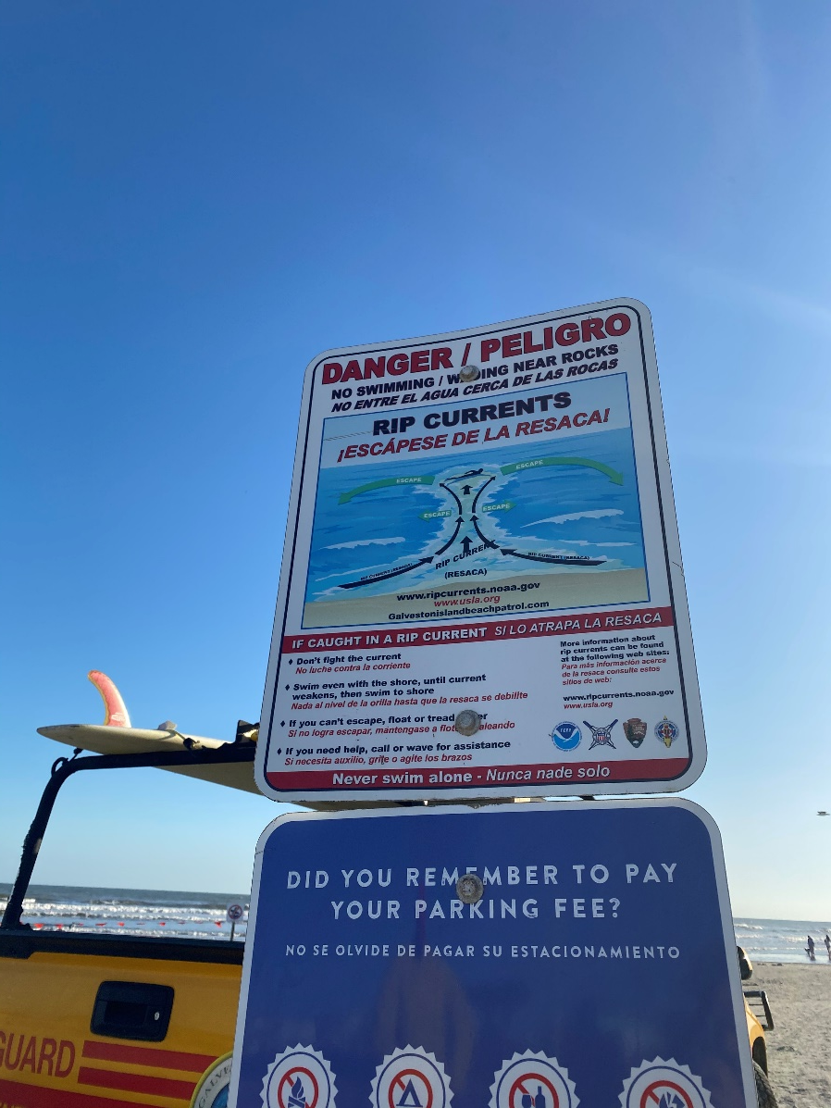
Facts about rip currents
Rip current speeds average 1 to 2 ft per second but they have been measured as fast as 8 ft per second – faster than an Olympic swimmer!
They do not pull people under the water, they pull people away from shore
Rips are sometimes mistakenly called undertow or rip tides, but these terms are not correct
Photo: Galveston, TX Beach Patrol - Rip safety sign
Notes:
Facts about rip currents
Rip currents average 1-2 ft per second, but stronger rips can be faster than an Olympic swimmer, or more than 8 ft per second.
People falsely assume that rip currents pull you under the water when in reality rip currents pull you away from the shoreline. People do not go under until they are too tired to swim or float.
Rip currents are also mistakenly referred to as undertow or rip tides, the proper scientific term is rip current.

Slide 5
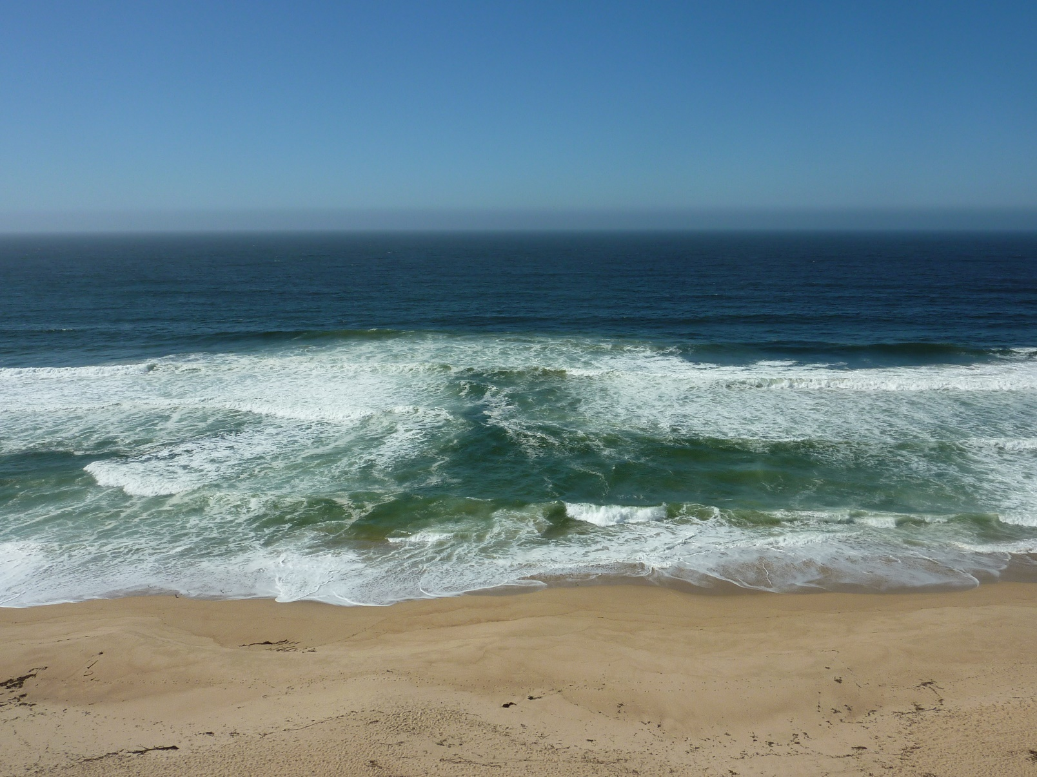
Three parts of a rip current
Rip currents have three parts: Feeders, Neck, and Head
Speeds are strongest in the neck, and they weaken beyond the breakers
The length and width of rip currents can vary dramatically
Head
Neck
Feeder
Feeder
Photo: Marina Beach, California (Dr. Brander)
Notes:
Three parts of a rip current
Rip currents are composed of three parts – feeder(s), neck, head. Depending on the incoming wave angle some rip currents may only have one feeder.
Rip currents begin as feeders near the shoreline, the neck is the area that carries people away from the beach, and the head is where the rip disperses - typically beyond the breaking waves.
The speeds are strongest in the neck, where people typically begin to realize they are in trouble.
Rip currents can be narrow, or more than 50 yards wide.
They sometimes end just beyond the line of breaking waves; however, others may continue to flow hundreds of yards offshore.
The current’s speed and length in the surf zone can make it very dangerous to swimmers of any skill, especially for those who do not know what to do if they are caught in a rip.

Slide 6
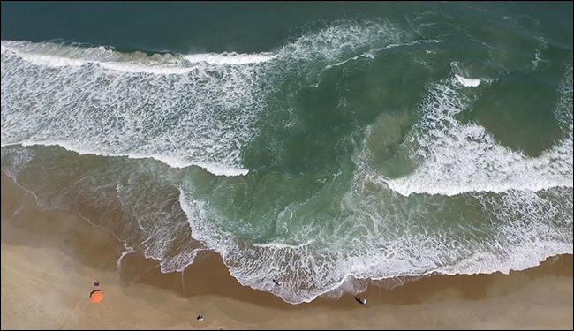
How do rip currents form?
Rips form as incoming waves push water up the slope of the beach
To remain in balance, excess water building in the surf zone seeks the path of least resistance as a rip current through the surf zone
Incoming Waves
Incoming Waves
Rip Current
Photo: NOAA
Notes:
How do rip currents form?
Rip currents develop as a result of incoming waves pushing water up the slope of the beach.
To stay in balance the incoming water seeks the path of least resistance back through the surf, which is typically a break in the sandbar or other unevenness in the ocean bottom.
The strength of a rip current can change depending on the tide level and amount of waves moving toward shore.
The NWS forecasts rip current activity based on expected wave height, wave period, wind direction/speed, and tidal fluctuations through wave models and by monitoring ocean observations through weather buoys. These are forecasts. Actual conditions may vary.
Rip currents can be observed almost every day, though most of them are weak. However when the NWS determines that rip currents could become strong they alert the public with special statements. The NWS’s Surf Zone Forecast also includes a section for the daily rip current outlook, and Moderate or High Risk are highlighted when conditions warrant.
Pay attention to these forecasts, visit lifeguarded beaches, and check with lifeguards for their safety advice because rip current activity can change.

Slide 7
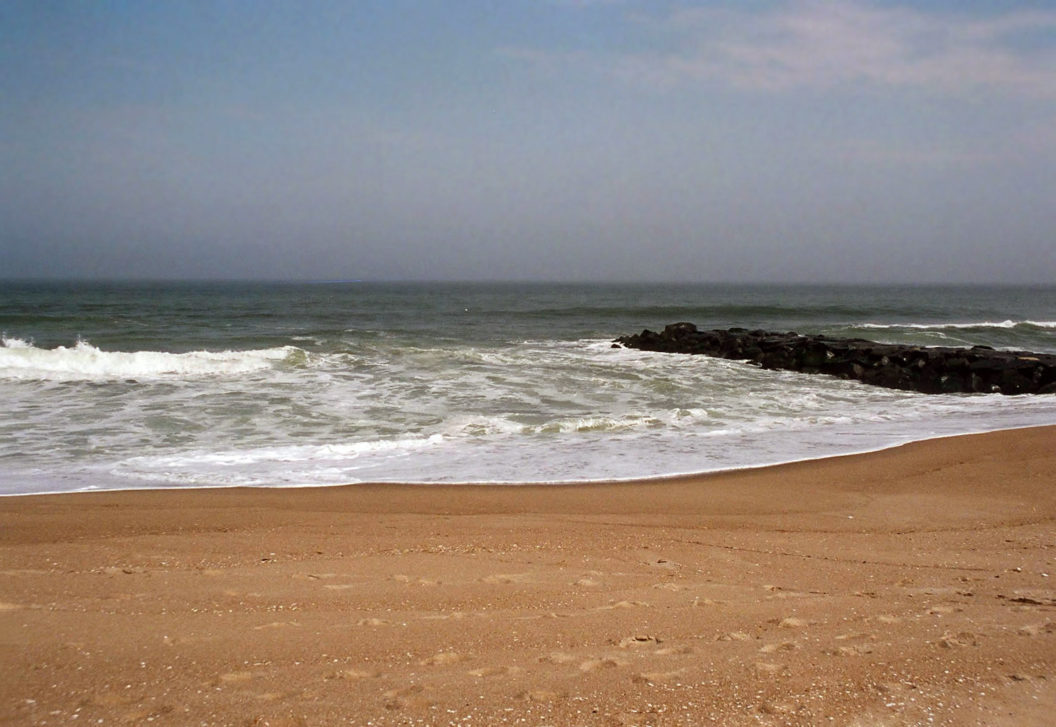
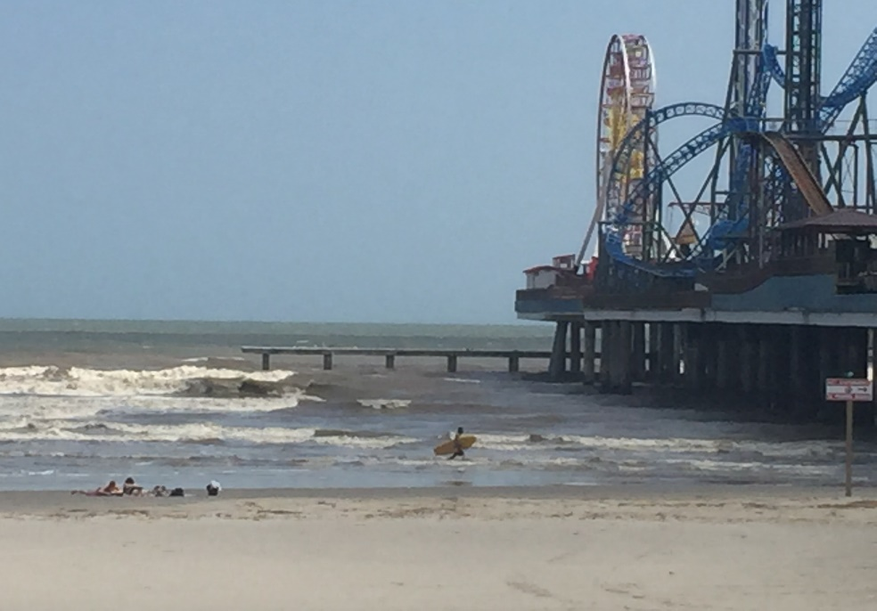
Structure caused rip currents
Rip currents often form beside structures
These currents can be strong
Stay clear of structures
Photo: Stevens Institute of Technology – New Jersey
Photo: Pleasure Pier, Galveston, TX (Galveston TX Beach Patrol)
Notes:
Structure caused rip currents
Wherever structures extend from shore toward the water, they can cause rip currents.
Waves or currents moving along the shore (known as longshore currents) push water toward the structure and the only outlet for the water is along the structure itself. As a result, the current in these areas can be very concentrated and very strong.
These currents are commonly present beside piers, groins, jetties, and even at natural promontories.
Stay well clear of structures to avoid these currents.

Slide 8
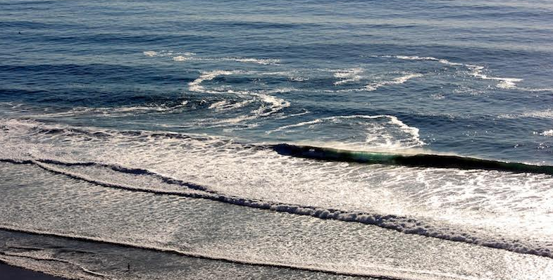
Why are rip currents dangerous?
Rip currents pull people away from shore
They are often hard to identify in the surf and not everyone knows about rip current dangers
Sometimes the worst events occur with the best weather
People try to out-swim them versus swim out of them
Photo: Chris Brewster - Blacks Beach, San Diego, CA Feb 9, 2012
Notes:
Why are rip currents dangerous?
Rip currents can be dangerous for several reasons, especially when they are very long. Note the large size of this San Diego rip current compared to the person in the lower left side of the image highlighted in yellow!
There are several reasons why rip currents are referred to as “Drowning Machines” by lifeguards, but mainly because…
They carry people away from the safety of the beach and shallower water.
They can be very hard to spot, especially when the surf is rough, or they don’t understand what to look for.
The worst events often occur with the best weather. This occurs when a storm is far enough offshore that the weather is locally nice at the beach. Meanwhile, swells from the distant storm move toward the beach creating a perfect surf environment for the formation of strong rip currents. People make the mistake assuming that surf conditions will be nice if the weather is nice!
Lastly, people try to get from where they are swimming to the beach in the shortest way which means they often swim directly against the current. Eventually they get tired and find themselves in a dangerous situation and panic.

Slide 9
How to spot a rip current
A narrow gap of darker, seemingly calmer water between areas of breaking waves and whitewater
A channel of churning, choppy water
A difference in water color
A line of foam, seaweed or debris moving seaward
Photo: NOAA – Big Sur, Monterey, CA
Notes:
How to spot a rip current
While rip currents may be hard to spot there are some clues you can look for. If you are ever in doubt then ask a lifeguard, especially if you are at a guarded beach and they will let you know if they have observed any.
It is easier to spot rip currents from higher vantage points, and more difficult at the water’s edge
Some of the clues include:
A narrow gap of darker, seemingly calmer water flanked by areas of breaking waves and whitewater (as in the picture in the slide)
A channel of churning/choppy water that is distinctive from surrounding water
A difference in water color, such as an area of muddy appearing water which occurs from sediment and sand being carried away from the beach
A consistent area of foam or seaweed being carried through the surf
With the stronger rip currents you may be able to observe the water flowing away from the beach out through the surf zone.

Slide 10
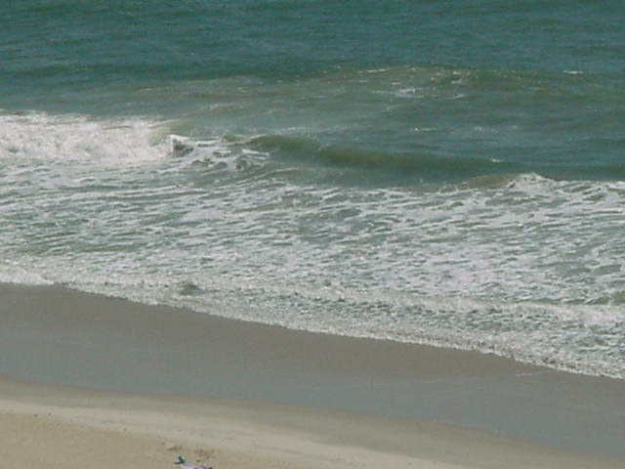
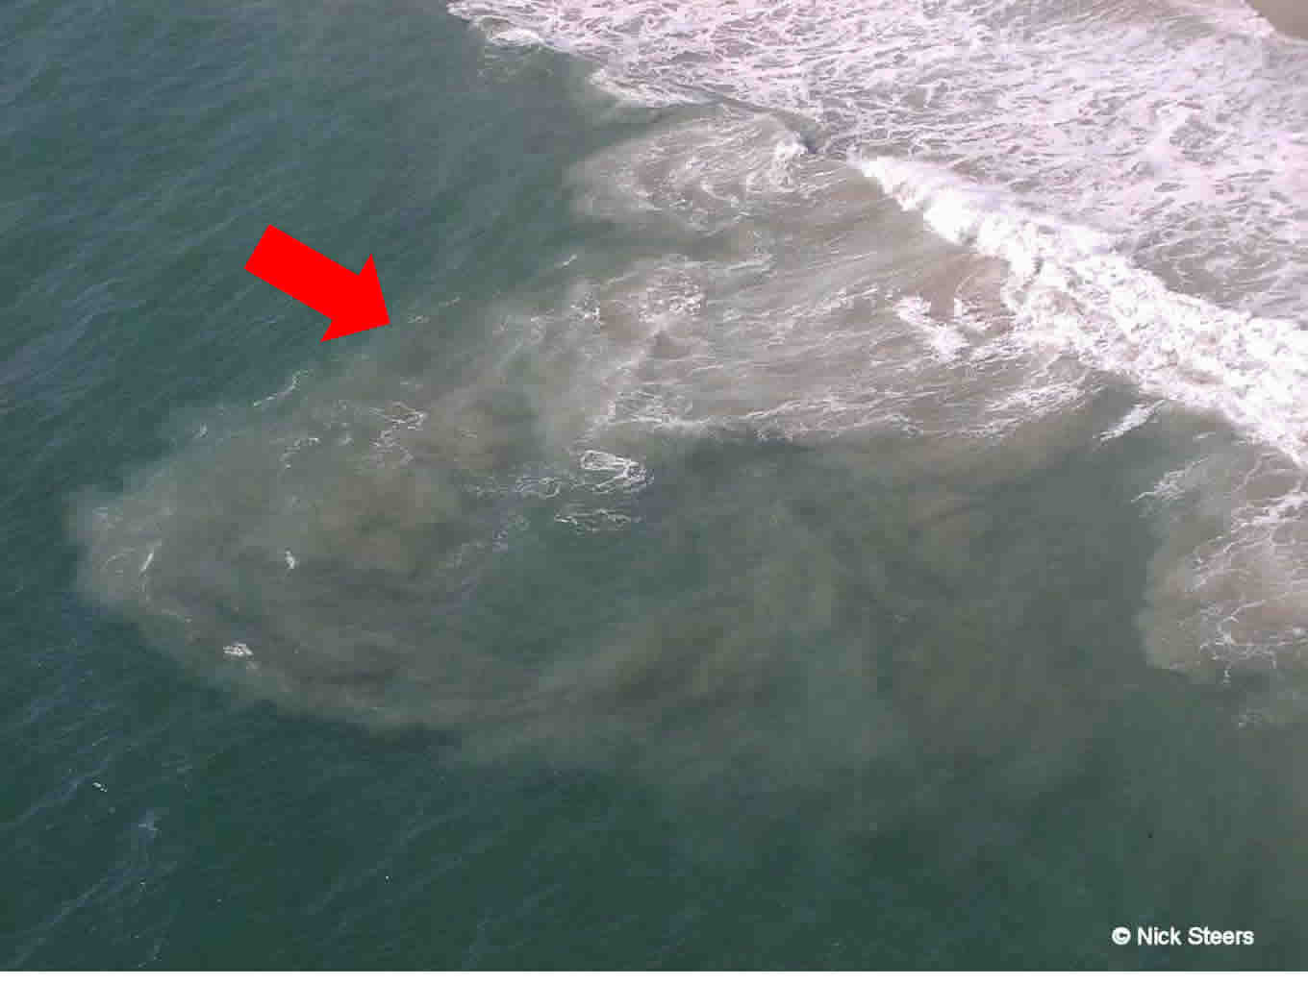
Can you find the rip current? Exercise 1
A difference in water color
B
A difference in water color
C
A
Photo: Carolina Beach, NC Police Department
Notes:
Can you find the rip current? – Exercise 1
Note: This slide has built in transitions that need to be advanced by hitting the spacebar, or a mouse or clicker, to transition after you ask the initial question.
<Ask the audience if they can spot the rip current based off the information provided from the previous slide and have them determine if the rip is located at “A, B, or C”, then pause. After the pause hit the spacebar, or advance with the mouse or clicker, to transition to the answer.>
<Hit the spacebar again, or advance with the mouse or clicker, to transition to a new image that shows another example.>
The image on the left is from Carolina Beach, NC and shows an example of difference in water color, in particular an area with muddy appearance as sand is being carried away from the shoreline. The rip current is located at “B” in this example.
The image on the right is another example of water color differences and note it is easier to see this rip current because of a higher vantage point

Slide 11
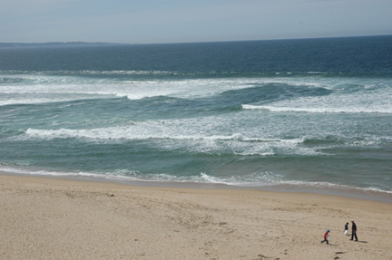
Can you find the rip current? Exercise 2
Area of seemingly calmer water no breaking waves through the surf
C
A
B
Photo: NOAA
Notes:
Can you find the rip current – Exercise 2
Note: This slide has built in transitions that need to be advanced by hitting the spacebar, or a mouse or clicker, after you ask the initial question.
<Ask the audience if this rip current is located at “A, B, or C” and pause for a moment. After the pause hit the spacebar, or a mouse or clicker, to transition to the answer.>
This is an example of an area of seemingly calmer water in the surf and the rip current is located at “C”.
It looks calmer because waves break as they strike shallow water, but rip current channels are typically deeper than adjacent areas, so waves don’t break there.
The breaking waves are a clue where the general location of sandbars are, while the area that has no breaking waves is a clue as to where to find the rip current.
Note: This long rip current extends through the entire surf zone, but because this one moves diagonally away from shore, a person swimming directly to shore may swim across the rip and out of it, instead of against it.
Spots where waves aren’t breaking may seem like great places to swim, but they might not be safe at all!
As this example notes, not all rip currents are perfectly perpendicular to the shoreline, some of them may be at an angle as they move away from the shoreline.

Slide 12
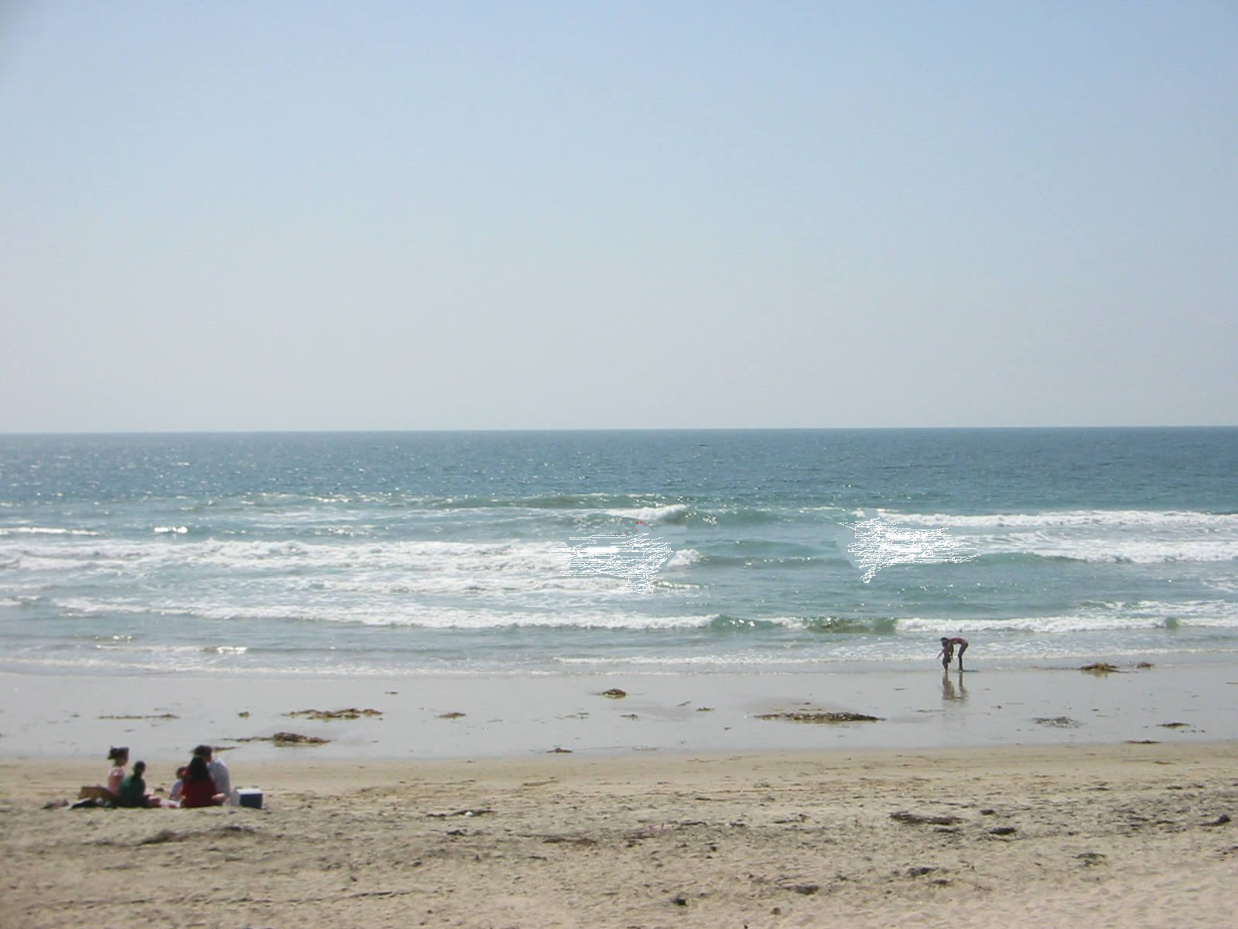
Can you find the rip current? Exercise 3
Another example of a rip in an area that looks calmer with no breaking waves
C
B
A
Photo: Chris Brewster – Pacific Beach, San Diego, CA
Notes:
Can you find the rip current – Exercise 3
Note: This slide has built in transitions that need to be advanced by hitting the spacebar, or a mouse or clicker, after you ask the initial question.>
<Ask the audience if this rip current is located at “A, B, or C” and pause for a moment. After the pause hit the spacebar, or a mouse or clicker, to transition to the answer.>
Here’s another example of a rip current identified by an area with no breaking waves and is located at “B”. Note that the two people down by the water may be completely unaware of this rip current and enter the water in the rip.
The whitewater from waves breaking on the sandbar on either side of the rip current would be a great place to swim toward if you were caught in this rip current.
You might be able to simply stand up if you can get to the sandbars.

Slide 13
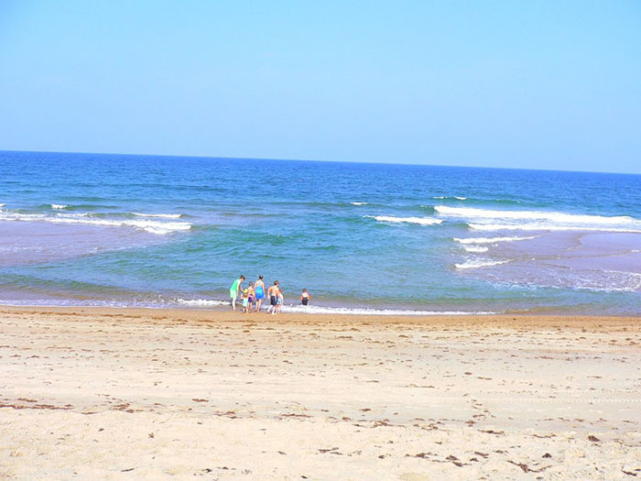
Can you find the rip current? Exercise 4
Rip current in the darker area (deeper water) between sandbars
C
A
B
Shallow water over the sandbar
Shallow water over the sandbar
Photo: NOAA
Notes:
Can you find the rip current – Exercise 4
Note: This slide has built in transitions that need to be advanced by hitting the spacebar, or a mouse or clicker, after you ask the initial question.>
<Ask the audience if this rip current is located at “A, B, or C” and pause for a moment. After the pause hit the spacebar, or a mouse or clicker, to transition to the answer.>
The rip current in this picture located at “A” and is darker than the surrounding water which is lighter on each side of the rip because the sandbars are nearly exposed.
Rips may look darker because they are deeper compared to the sandbars, thus sunlight has a harder time penetrating to the bottom in the deeper areas and therefore appears darker compared to the shallower areas.
<Also ask the audience to consider what they would do if they saw this rip current and saw the family enjoying time right in front of the rip. Hopefully someone would state that they would tell the family about the lurking danger and teach them how to spot the rip.>

Slide 14
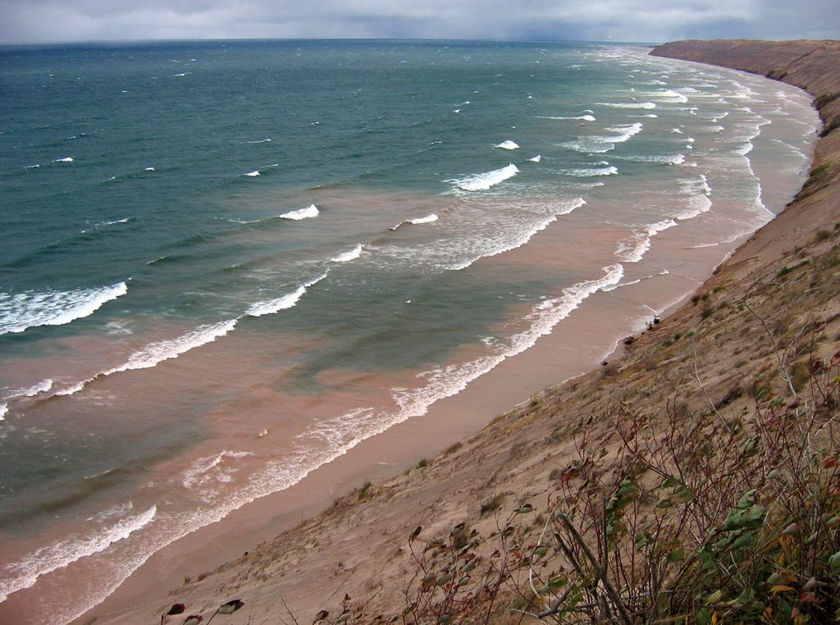
How many rips in this picture? Exercise 5
Example of multiple rip currents highlighted by a difference in water color as sediment is being carried away from the shoreline by the rips
3
2
1
Photo: Michigan Sea Grant – Lake Michigan
Notes:
How many rips in this picture? – Exercise 5
Note: This slide has built in transitions that need to be advanced by hitting the spacebar, or a mouse or clicker, after you ask the initial question.>
<This is the last exercise - ask the audience how many rip currents they see in this picture and pause a moment. After the pause hit the spacebar, or a mouse or clicker, to transition to the answer.>
There are at least three visible rip currents in this picture (one at the left, one in the center, and one in the distance at the top right>.
This is a Great Lakes example with multiple rip currents identified by differences in water color caused by sediment being carried away from the shoreline. Recall that rip currents can occur along the shoreline of any body of water that experiences breaking waves - including the Great Lakes.
Note the contrast of the appearance of these rips as opposed to the rip current in the previous slide. As mentioned, the rip currents are the discolored “muddy” areas of water with sediment being carried away from the shoreline. Where in the previous slide the rip current was the darker area associated with very little wave activity.
Remember, it is easier to spot rip currents from higher vantage points and it’s not always easy to spot them.

Slide 15
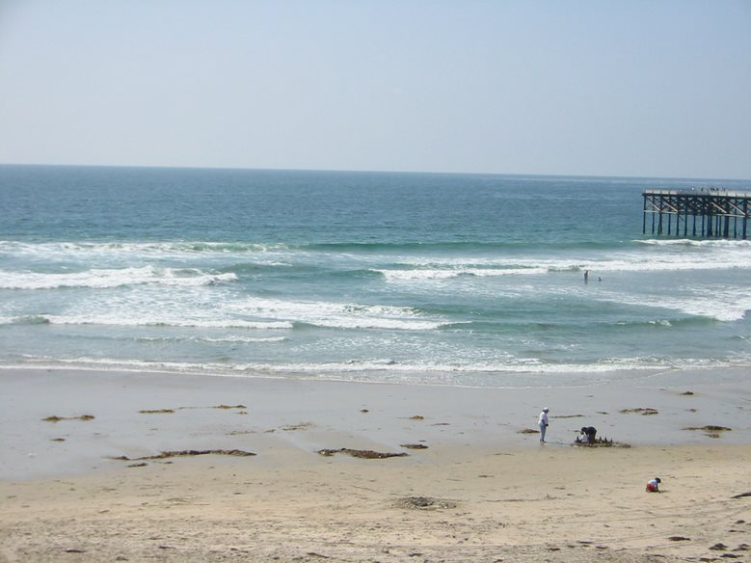
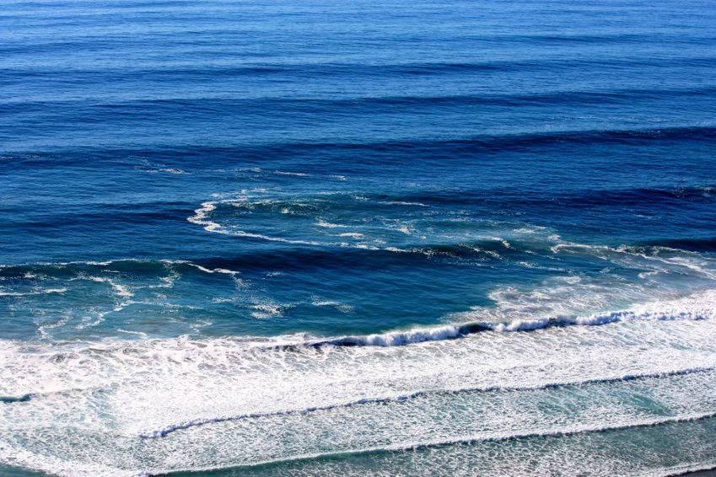
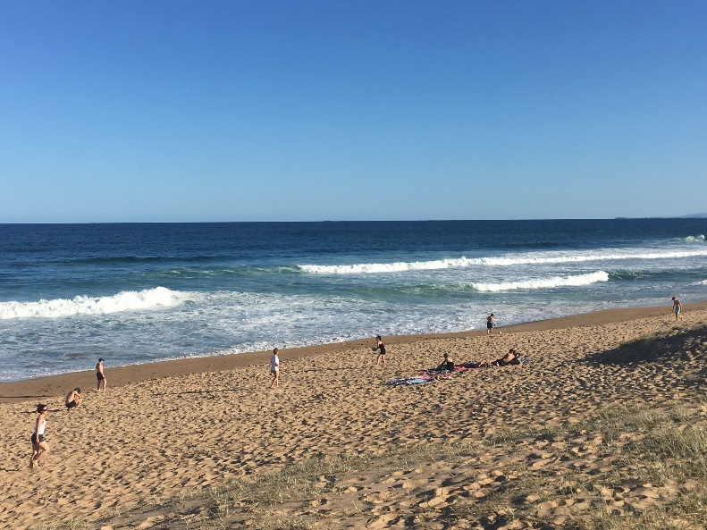
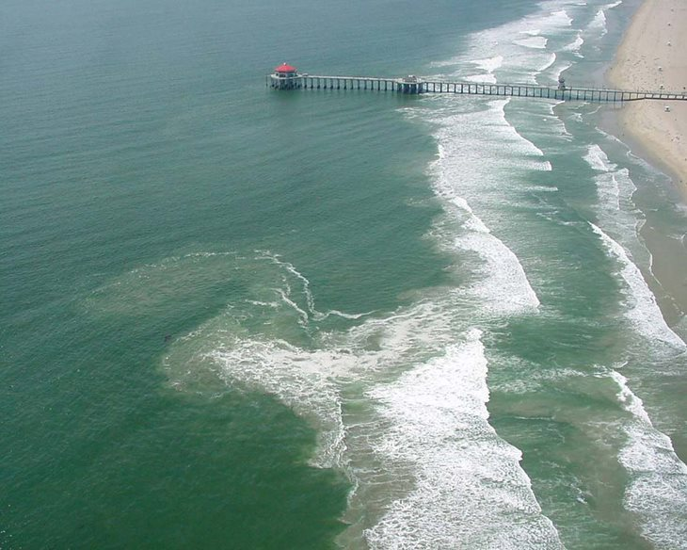
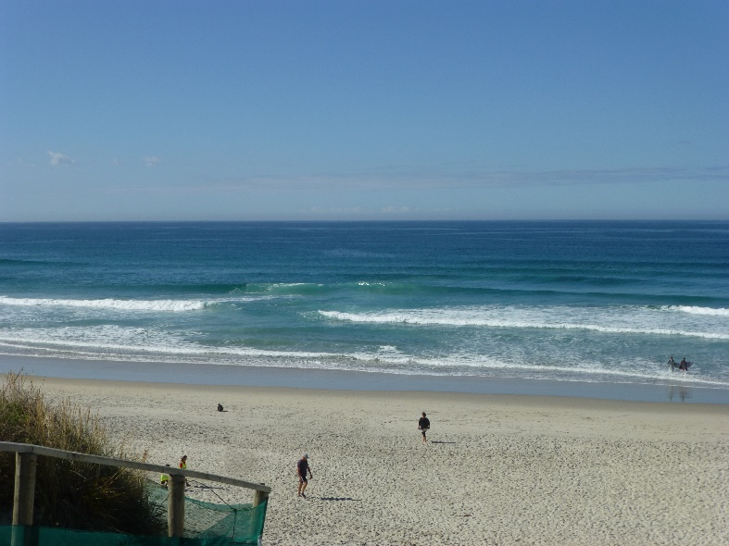
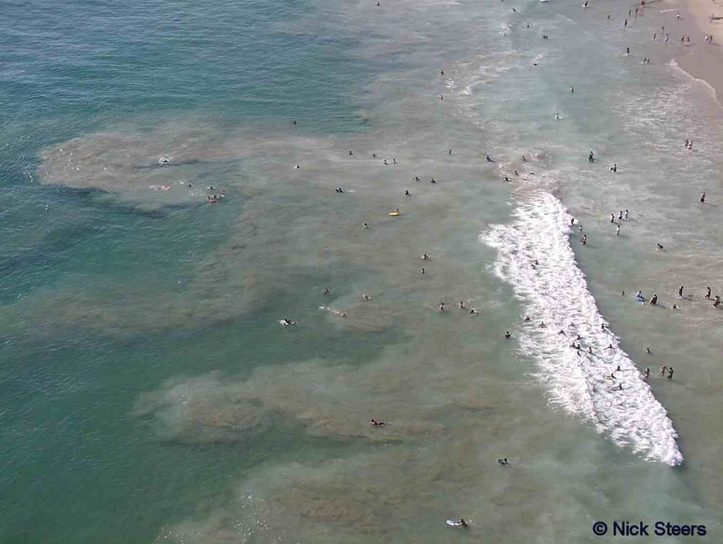
Not all rip currents are created equal
Pacific Beach, San Diego, CA (Chris Brewster)
Black’s Beach, San Diego, CA (Chris Brewster)
Stanwell Park, Sydney, Australia (Dr. Brander)
Huntington Beach, CA (Chris Brewster)
St Kilda Beach, Dunedin, South Island New Zealand
(Dr. Brander)
Zuma Beach, Malibu, CA (Nick Steers)
Notes:
Not all rip currents are created equal
While all rip currents consist of the same components there are variations highlighted by differences in width, length, color, and orientation with the beach (perpendicular or angled).
These variations are often a result of the local sea bottom conditions, interactions with structures and coastal geography, slope of the beach, and type of beach (ie. sand, reefs, stone, etc.).

Slide 16
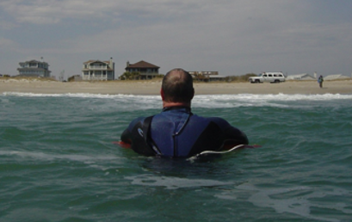
How do I know if I am caught in a rip?
It’s not always obvious if you are caught in a rip
As you are swimming toward shore you are not making any progress and becoming tired
With stronger rips you may feel that you are being pulled away from the beach
Photo: Wrightsville Beach Ocean Rescue, NC
Notes:
How do I know if I am caught in a rip?
Sometimes victims who escape rip currents, or are rescued by lifeguards, say that they didn’t realize they were in a rip current.
Often the first sign you experience is you are making no progress swimming toward shore and becoming tired.
In some cases it will be obvious that you are caught in a rip current, especially the stronger ones, as you feel yourself being carried away from the beach.
Ultimately, as soon as you recognize that you are, or may be, in danger then take action to protect yourself!

Slide 17
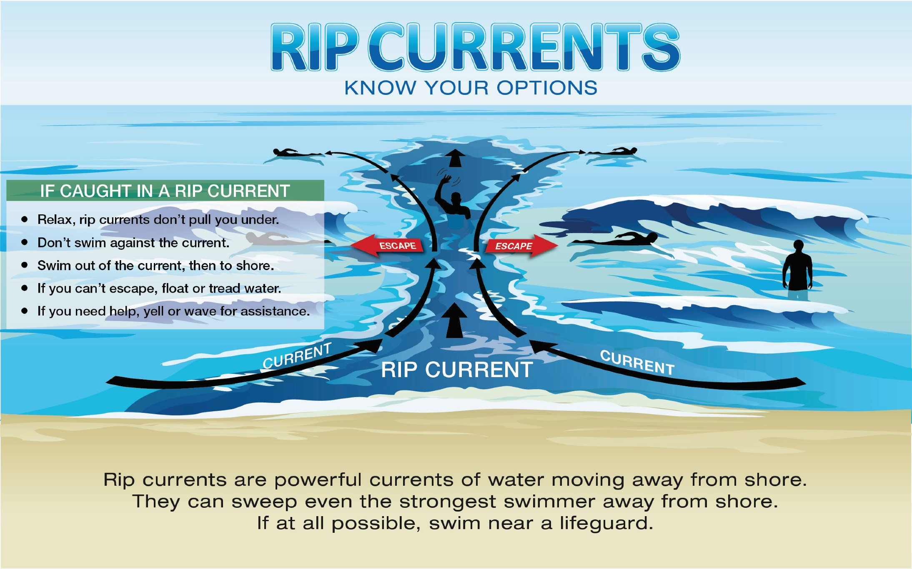
What can I do if I am caught in a rip?
Image: USLA/Sea Grant/NOAA
Notes:
What can I do if I am caught in a rip?
This diagram depicts the options for escaping a rip current.
If you have the strength, then swim to the side, or parallel, to the beach as soon as you realize you are in danger.
Once you are out of the rip, use the waves to push you back to shore.
In addition, once you are out of the rip and near a sandbar you may be able to stand up in some cases, remember areas where waves are consistently breaking may be a clue that a sandbar is nearby.
If you don’t have the strength to swim, then stop swimming, float, and wave for help, some rip currents may recirculate you back toward shore.

Slide 18
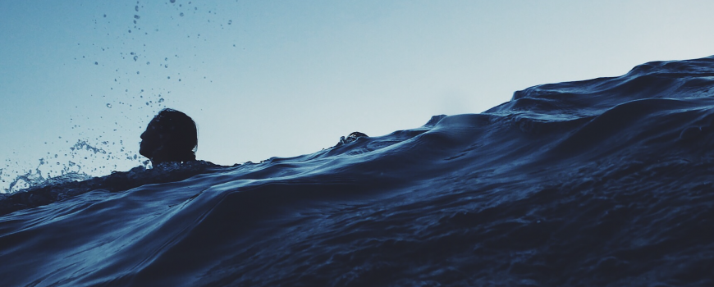
How do I help someone else?
Know your options!
Don’t put yourself at risk
Get help from a lifeguard
If a lifeguard is not present, call 9-1-1, then try to direct the victim to swim following the shoreline to escape
If possible, throw the rip current victim something that floats
Never enter the water without a flotation device
Photo: California Sea Grant
Notes:
How do I help someone else?
Don’t become a victim while trying to help someone else!
Many people have died trying to rescue rip current victims.
Leave rescue to professionals who are properly trained and equipped.
If you feel you must enter the water, first call 9-1-1 or have someone do so, and always take a flotation device with you, ideally a US Coast Guard approved life jacket.
Always keep the floatation device between you and the victim (unless it is a life jacket you are wearing) and be ready to back away if in danger. This is how professional lifeguards protect themselves from panicked victims.
Panicked drowning victims can pull others underwater, causing a double drowning. In other cases, each year, would-be rescuers die, while the rip current victims extricate themselves.
Don’t become a statistic!

Slide 19
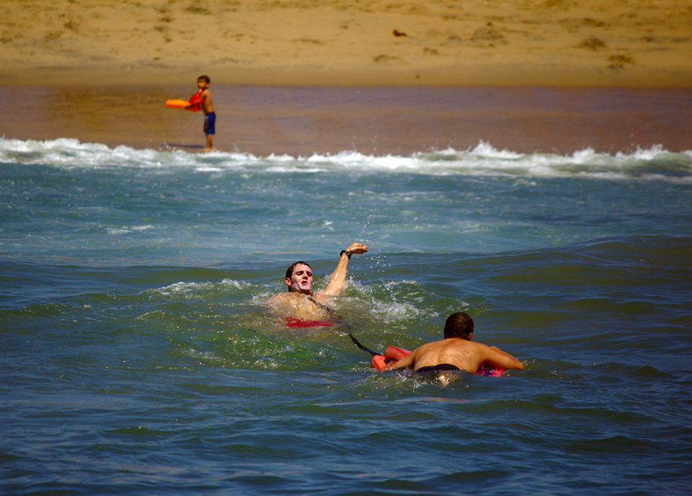
What are some other safety tips?
Know how to swim
Swim near a lifeguard
Never swim alone
If in doubt, don’t go out!
Photo: USLA
Notes:
What are some other safety tips?
Here are some key ocean swimming safety tips from the United States Lifesaving Association that people who go to the beach should be very familiar with to remain safe:
Know how to swim – take the time to learn to swim and remember swimming in the ocean is not the same as a pool.
Swim near a lifeguard, never take your attention away from your family/friends while at the beach.
Never swim alone.
The only safe flotation device is a USCG approved lifejacket in a proper size for you.
When in doubt, don’t go out, it’s always better to swim another day when conditions are safer!

Slide 20
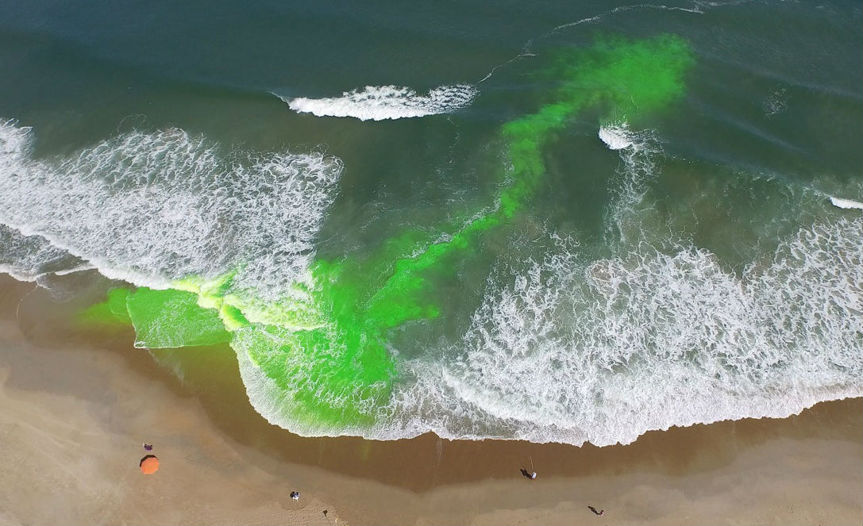
Thank you & have a safe trip to the beach!
National Weather Service
https://ripcurrents.noaa.gov
United States Lifesaving Association
https://www.usla.org/ripcurrents
Building a Weather-Ready Nation
Notes:
End slide
<Image: Dye release research conducted to show the rip current through the surf zone>
Help others learn more about the dangers of rip currents and how to stay safe while visiting the beach!
<Ask the audience if they have any questions, or would like to share their own story about rip currents.>
For more information visit the NWS ripcurrents.noaa.gov and the USLA usla.org/ripcurrents websites.

