Slide 1
How Do I Register My C-Band Receive Only Earth Station(s)in the International Bureau Filing System (IBFS)?

Slide 2
This presentation will:
Provide brief background material on the ongoing Mid-band Proceeding and the earth station filing freeze and filing window;
Discuss how to submit an application to register a C-Band 3700-4200 MHz receive only earth station under 1 call sign at 1 location and consisting of 1 antenna;
Discuss how to submit an application to register a C-Band 3700-4200 MHz receive only earth station under 1 call sign at 1 location and consisting of many antennas; and
Answer questions.

Slide 3
Mid-band NOI and 3.7-4.2 GHz Freeze
Background
  Congress and the Commission have noted a need for additional spectrum for wireless broadband services, including 5G.
  Recently enacted MOBILE NOW Act directs the Commission to evaluate use or shared use of licensed or unlicensed services in the 3.7-4.2 GHz band, currently shared between fixed satellite service (FSS) (space to Earth) and Fixed Service (FS).
  Last year, the Commission issued a Notice of Inquiry on flexible use in between 3.7 GHz and 24 GHz. A Notice of Proposed Rulemaking is tentatively scheduled to be considered at the July Open Commission Meeting.
  On April 19, 2018, the International, Wireless Telecommunications, and Public Safety and Homeland Security Bureaus released a public notice imposing a freeze on applications for operations of earth stations and fixed microwave links in the 3.7-4.2 GHz band, with some exceptions.

Slide 4
Scope of Freeze and Filing Window
Scope of Earth Station Freeze
  Applications for new or modified earth station licenses or registrations in 3.7-4.2 GHz band are subject to the freeze. Applications, or those portions of applications, requesting to operate in the 3.7-4.2 GHz band will be dismissed.
  The freeze does not apply to applications for renewal of an existing authorization, cancellation of an existing authorization, or modification to correct inaccurate data in an existing authorization.
  Applicants may request a waiver of the freeze, which will be assessed on a case-by-case basis.
Scope of 90-day Filing Window
  Applicants with existing earth stations (i.e. stations that were constructed and operational as of April 19, 2018) may file applications to license or register those earth stations in 3.7-4.2 GHz band.
  The freeze PN granted a waiver of the coordination report normally required as part of an application for license or registration of an earth station.

Slide 5
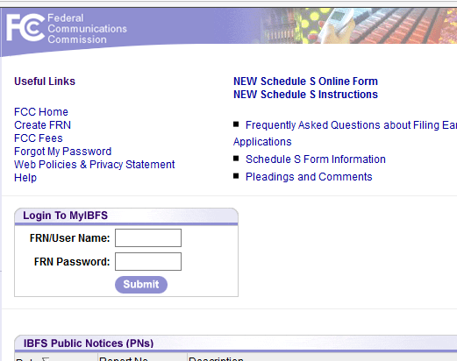
Basic Process
Preparation:
  Determine earth station location
  Determine satellite points of communication
  Determine frequencies of operation
  Determine transmitter power characteristics and receiver isolation requirements
  Develop application details/exhibits.
  Coordinates with terrestrial operators if any.
Submit application for a License to transmit and receive to a satellite or a Registration to only receive signals from a satellite
  File the application in MyIBFS
  Pay for your filing or request a filing fee waiver.
  Monitor your filing status

Slide 6
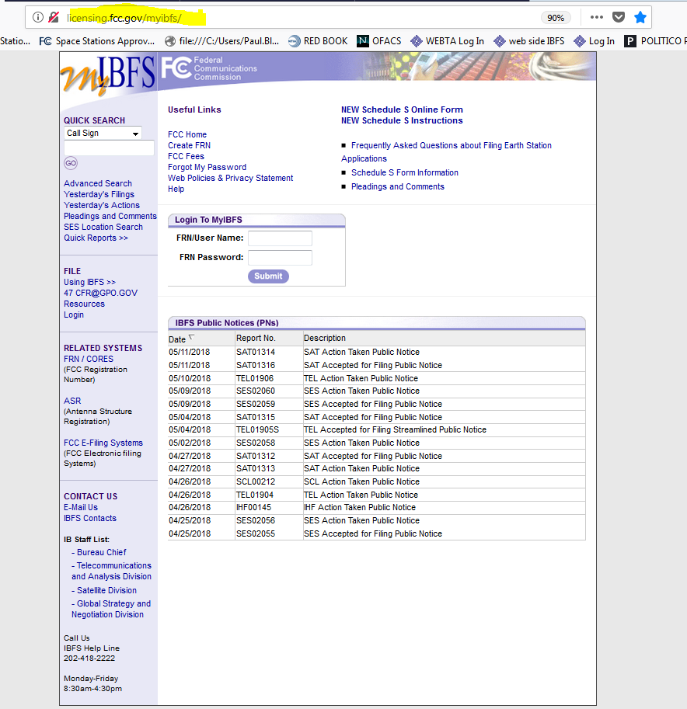
Getting Started
Go to : http://licensing.fcc.gov/myibfs/
To begin an application, enter your FRN & Password
If you do not have an FCC Registration Number, go to the FRN/CORES link in the left hand menu and register for one.
Additional information may be found at:
Frequently Asked Questions about Filing Earth Station Applications

Slide 7
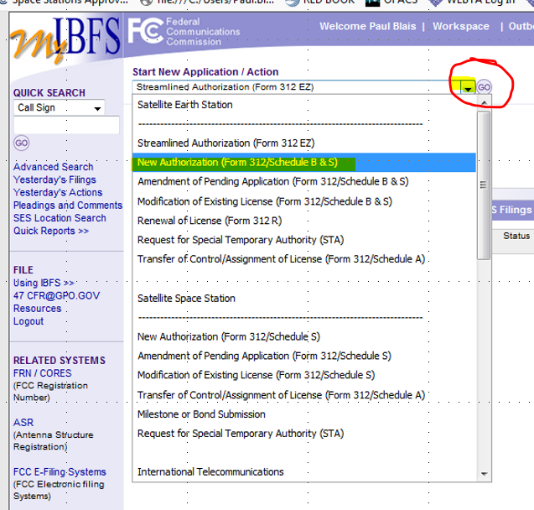
Select the type of application
Select New Authorization (Form 312/Schedule B & S)
Select “Go”

Slide 8
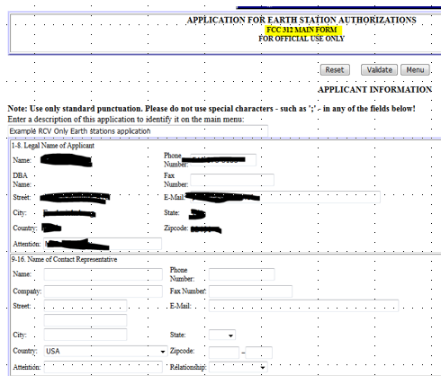
Form 312 questions 1-16
Verify the name of the Company, address and other information in 1-8. Edit available fields, if needed.
If pre-filled, verify the information in 9-16. Edit available fields, if needed.
If not pre-filled, fill in the point of contact who will answer questions about this application and license in 9-16

Slide 9
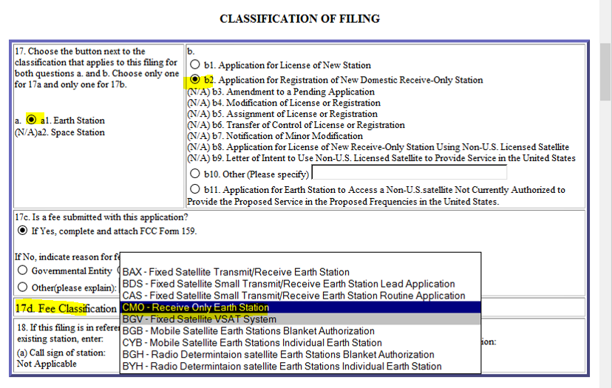
Form 312 question 17
Declare what type of application you are going to submit.
On for a new license, or a new registration or a modification of a currently authorized license. In this example the applicant is applying to register an earth station
If the applicant is paying a fee for this application, the fee classification code for a Registration is “CMO”
The cost, as published under FCC Fees , International Bureau is $435.00
Note: if an applicant is modifying its registration to update its station authorization, use Fee Code CGO. Cost is $200.00
… or …

Slide 10
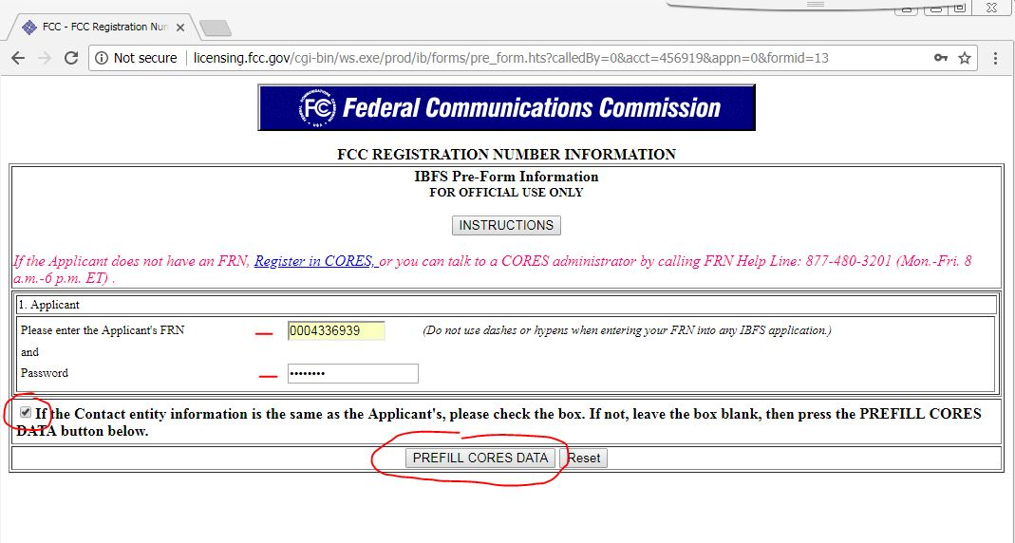
Establishing the Licensee Name and the Licensee point of contact.
If, “… Contact Info is the same as... Applicants…” check the box and click the “PREFILL CORES DATA” button
If applicant is not the same as the contact info and you checked the box, click “Reset”, then click the “PREFILL CORES DATA” button

Slide 11
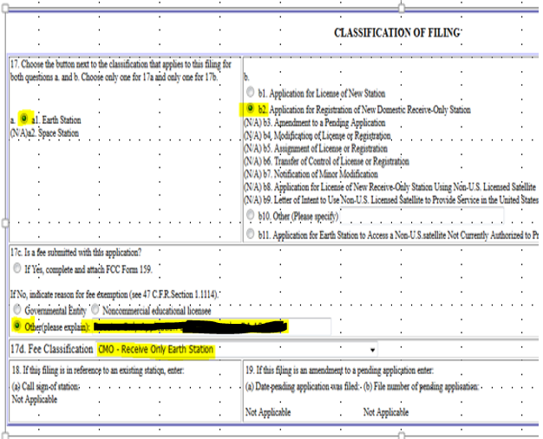
Form 312 question 17
(exemption)
If you are claiming exemption of filing fees under Sec 1.1116 of the Commissions Rules (47 CFR 1.1116), indicate your reason.
Use the appropriate fee code as published under FCC Fees , International Bureau.

Slide 12
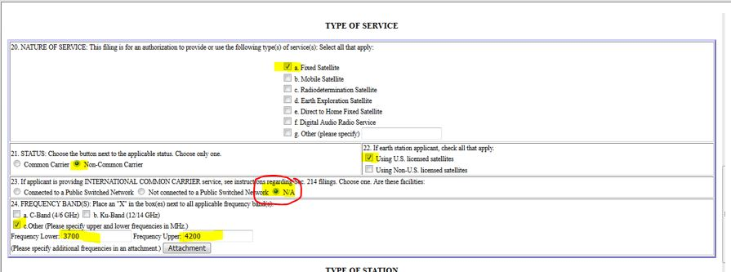
Form 312 questions 20-24
Fill out the “type of service” questions this way.
Note: See question 24. 24a is the appropriate answer. That is how most people answer it and that is what comes in on many of the previously filed Form 312 applications. 24c also works.

Slide 13
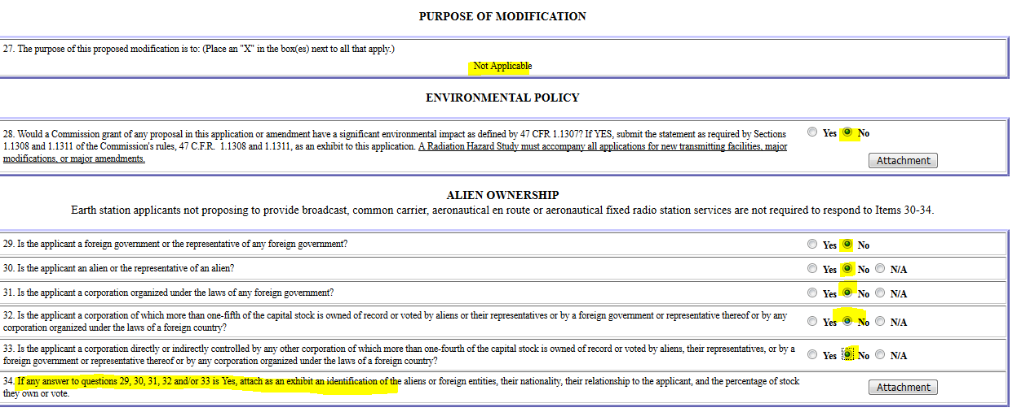
Form 312 questions 27-34
Question 28 is actually two questions. A. Is this earth station on an environmentally sensitive site? B. If your station transmits, have you completed a radiation hazard study and attached it to this application?
For questions 30-34, answer could also be N/A, but No works.

Slide 14
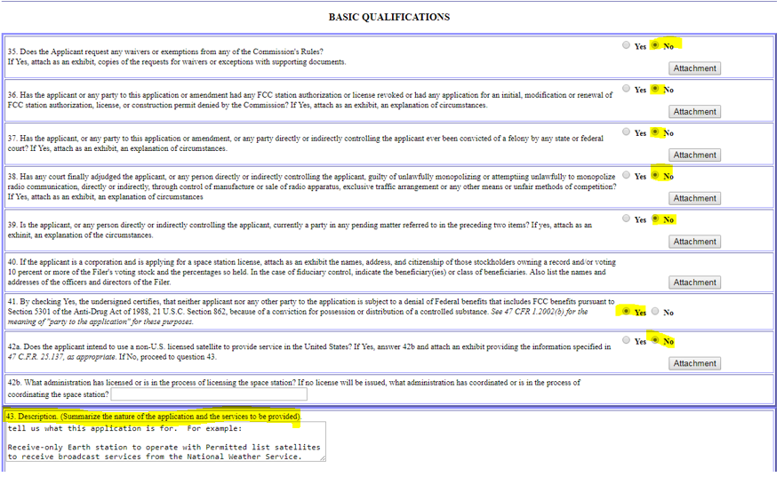
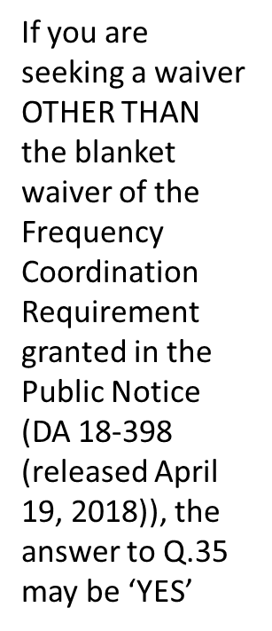
Form 312 questions 35-43

Slide 15
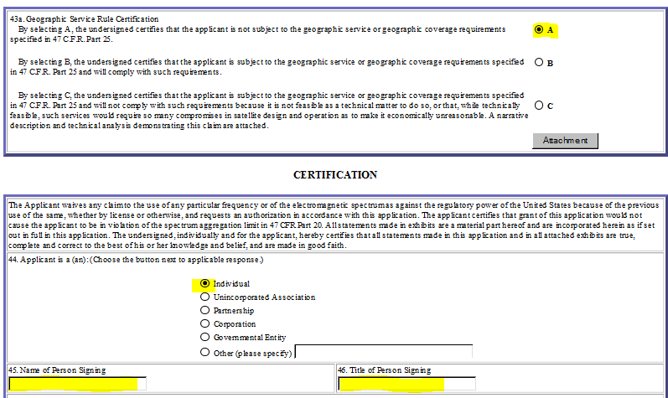
Form 312 questions 43 a - 46

Slide 16
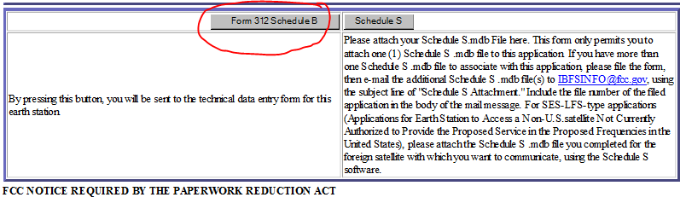
Form 312 Schedule B
Once you have completed the Form 312 above, and have passed validation, you must complete the Form 312 Schedule B to describe the particulars of your earth station and operations.

Slide 17
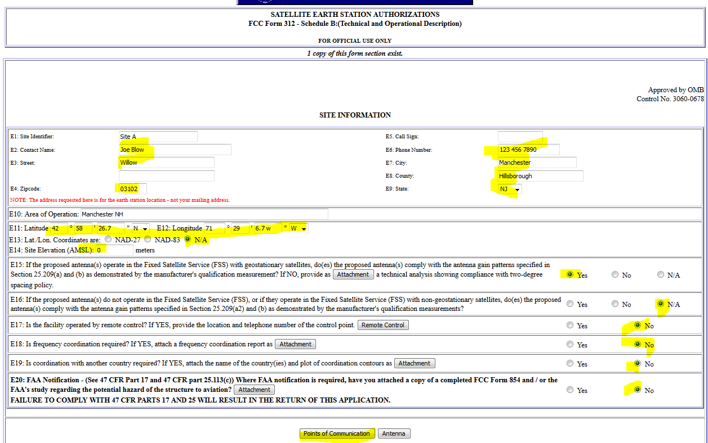
Form 312 Schedule B Questions E1- E20
Question E18: If you do not have a frequency coordination report to submit No. If you do have one respond yes.
Validate the page.
Click on “Points of Communication” for this “Site Identifier”
Click on “Antenna” to describe the antennas at this site.

Slide 18
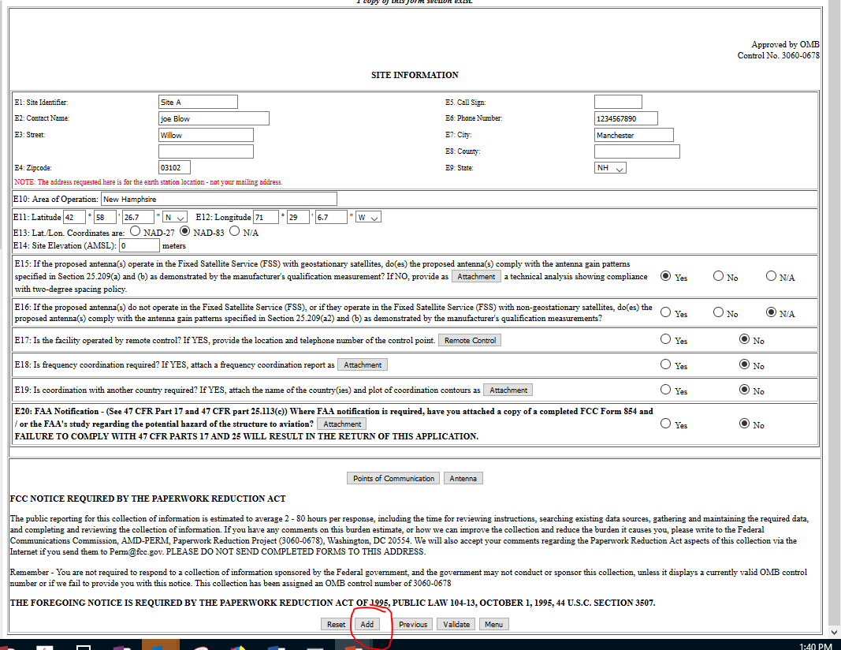
Form 312 Schedule B Questions E1- E20
Labels
On the SITE information you will see
Click “Points of Communication” to define/add satellite(s)
Click “Antenna” to define/add Antenna(s)
Click “Add” on the SITE Information screen to add a SITE.

Slide 19
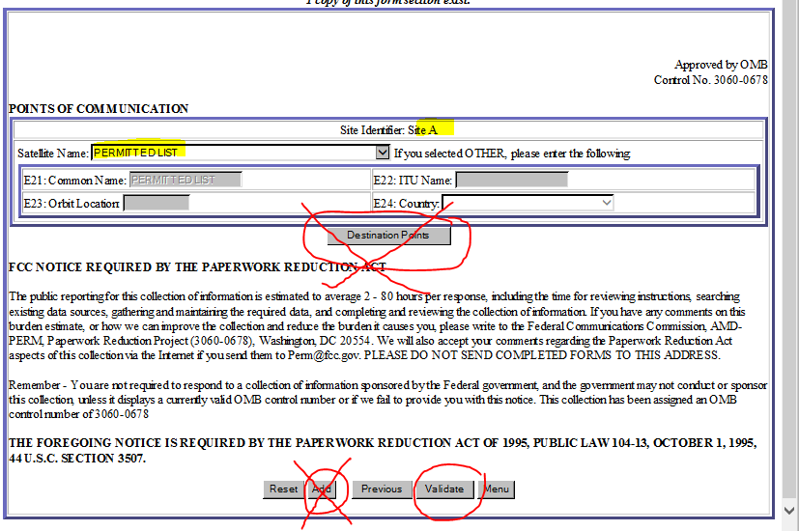
Form 312 Schedule B Questions E21- E24
Identify what satellite Site Identifier A is operating with. We chose “Permitted List”
This applicant does not claim any link to destination points because it is a receive only earth station.
If you would like to add another satellite Point of Communication, validate this information, then click the add button.
If there are no more PoCs, click Validate, then previous

Slide 20
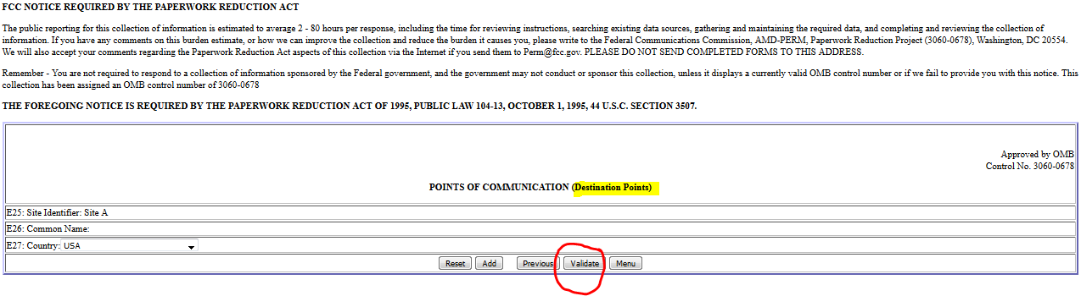
Form 312 Schedule B Questions E25- E27

Slide 21
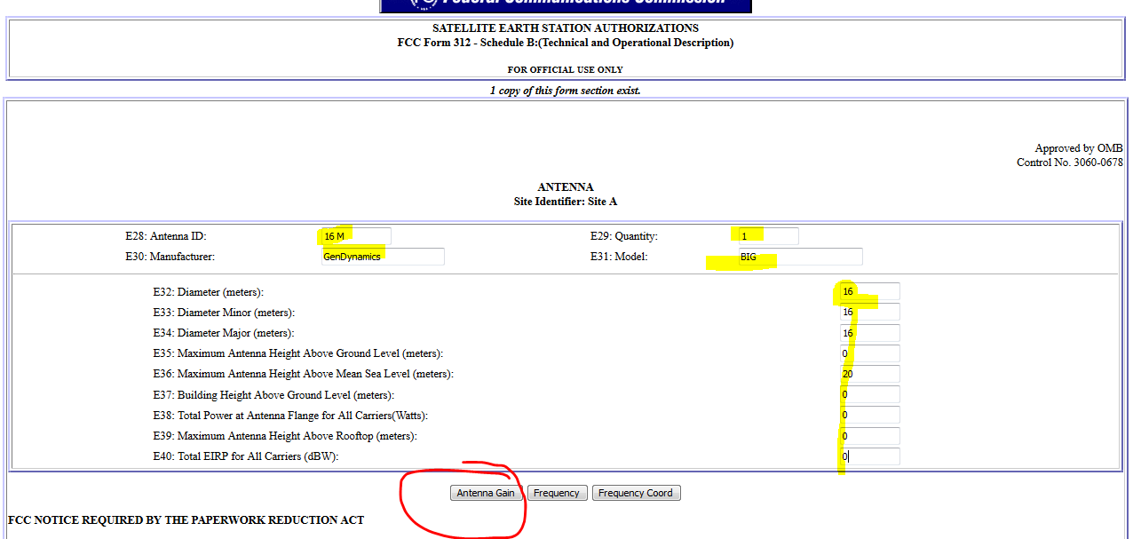
Form 312 Schedule B Questions E28- E40
Answer all the questions.
Validate.
Then click on Antenna Gain and complete those questions

Slide 22
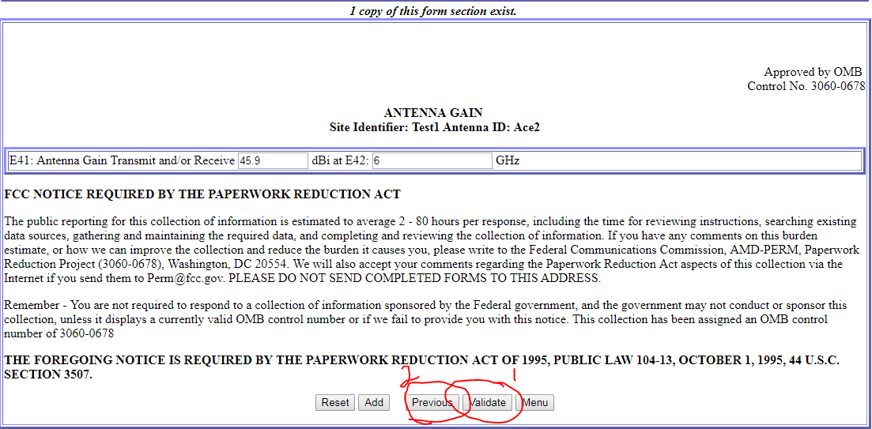
Form 312 Schedule B Questions E41
Please enter a main beam gain at the center frequency of the frequency band that you are applying for.
Validate your entry, then click Previous to return to the Antenna page.

Slide 23
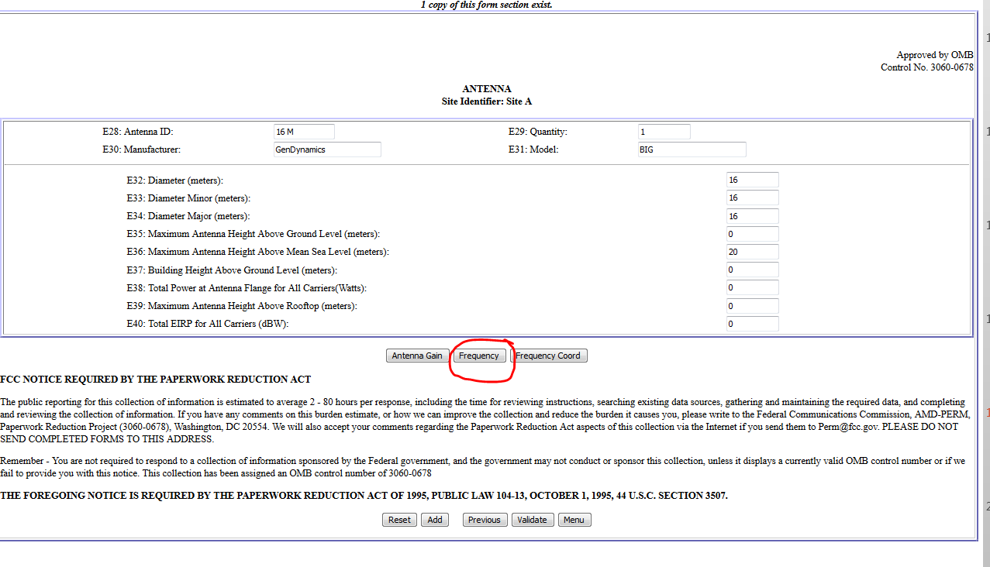
Form 312 Schedule B Questions
Click on Frequency button

Slide 24
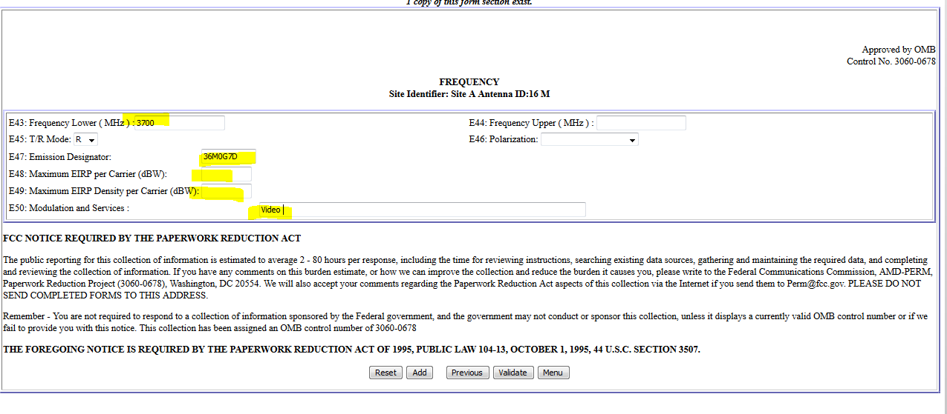
Form 312 Schedule B Questions 43-50
Answer all questions, validate, then click on previous.

Slide 25
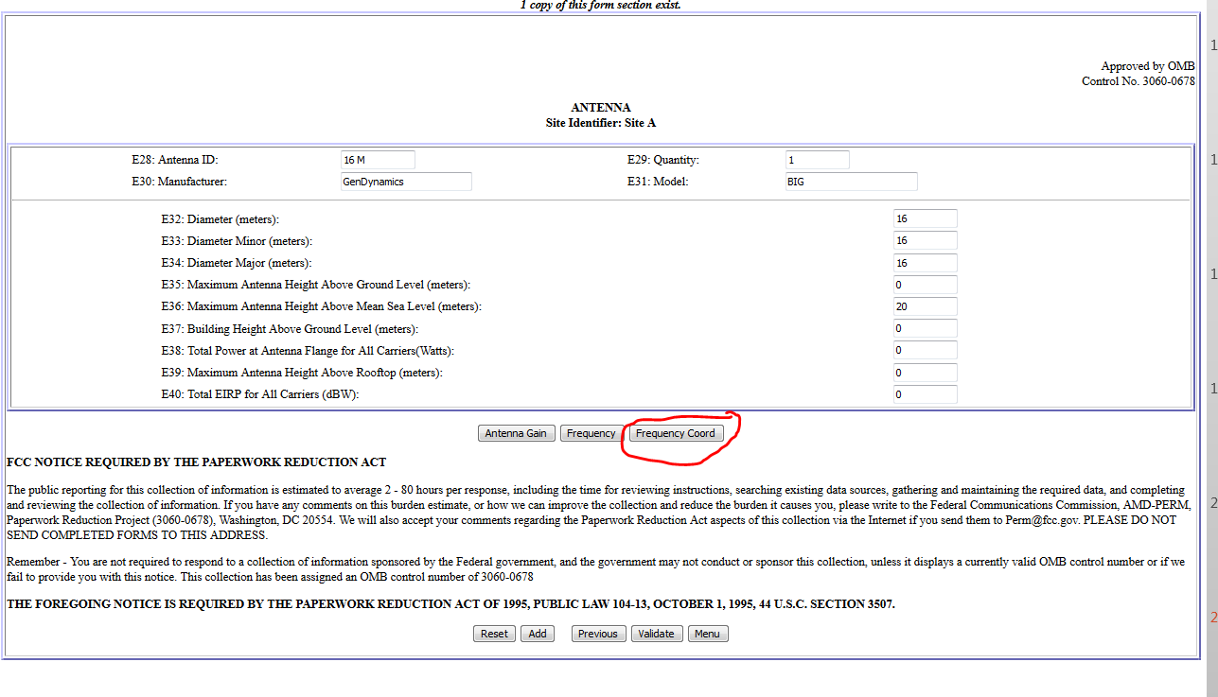
Form 312 Schedule B Questions
Click on Frequency Coordination button

Slide 26
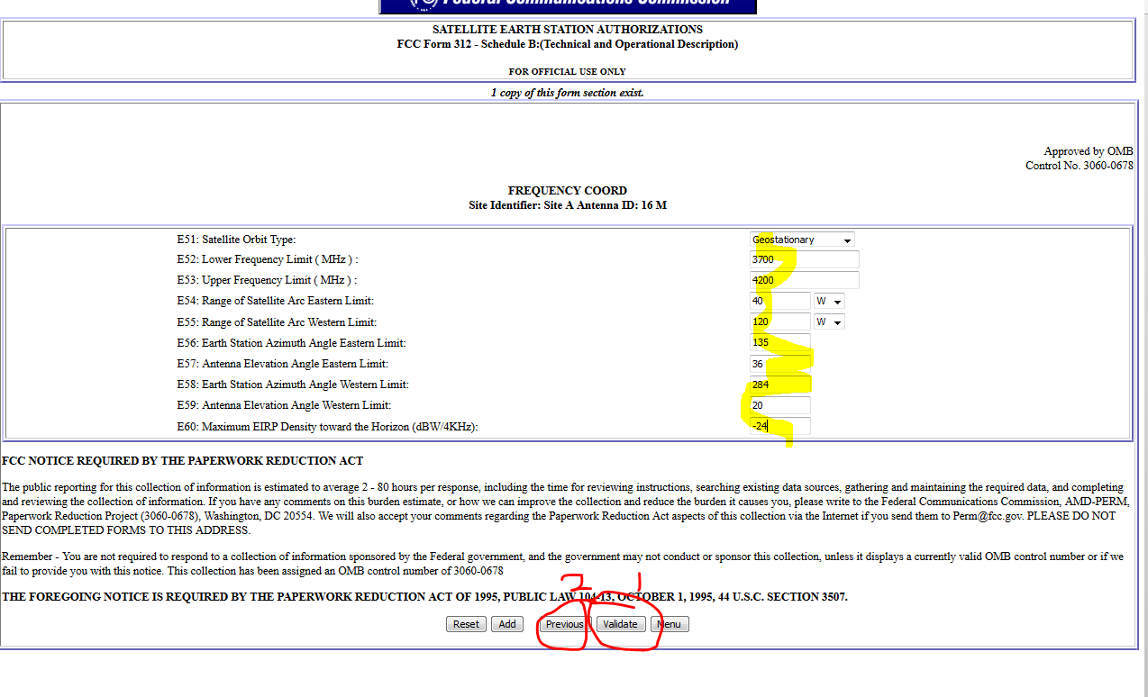
Form 312 Schedule B Questions 51-60
Complete all questions.
You can calculate the azimuth and elevation values for the east most satellite and the west most satellite by using an internet satellite pointing calculator such as http://www.satsig.net/ssazelm.htm
Validate and select previous to continue.

Slide 27
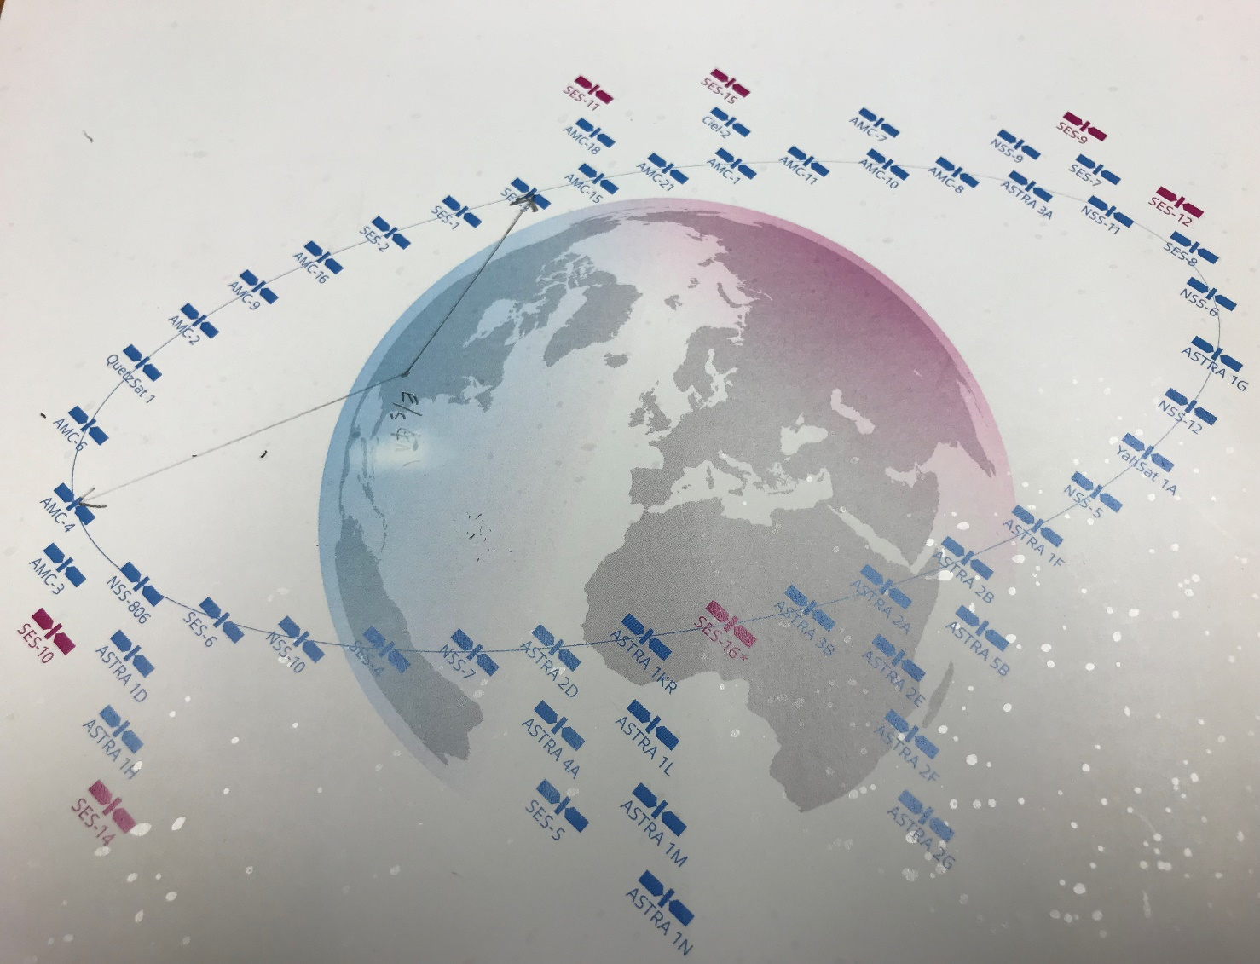
Form 312 Schedule B Questions 54-59 Values
Orange Lines are Vectors from an earth station to a satellite on the GSO Orbit. Together they describe a satellite arc.
Blue line identifies the antenna azimuth from True North to the Vector pointing to “AMC-4”
Green Line identifies the antenna azimuth from True North to the Vector pointing to “SES-3”
Red Lines represent the antenna elevations to the vectors pointed to each satellite.
If you indicate “Permitted List” in E21 then the orbital location of the satellite at the end of the vector point to AMC-4 would be the eastern limit required E54; to SES-3 Western limit in E55; E56 would be the angle from true north represented by blue line, E57 would be the angle from true north represented by green line.
Red lines are the angle of elevations of the antenna from the earth to each vector.
Calculate azimuths and angles using an earth to satellite pointing calculator on the internet such as http://www.satsig.net/ssazelm.htm
North Pole
Earth Station
Located in KY

Slide 28
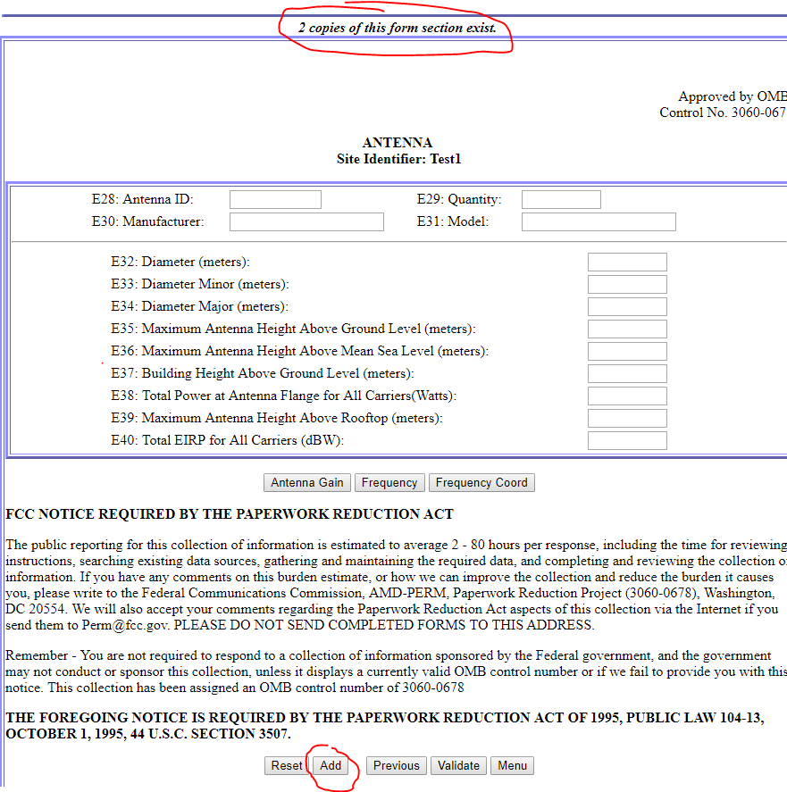
One location, multiple antennas
If you are registering more than one antenna at a single location, select Add to create another antenna form.
Fill in the additional form, including all the subforms (Antenna Gain, Frequency, and Frequency Coord) for each antenna added.

Slide 29
Once you complete all questions for each site and antenna, you are ready to submit your application.

Slide 30
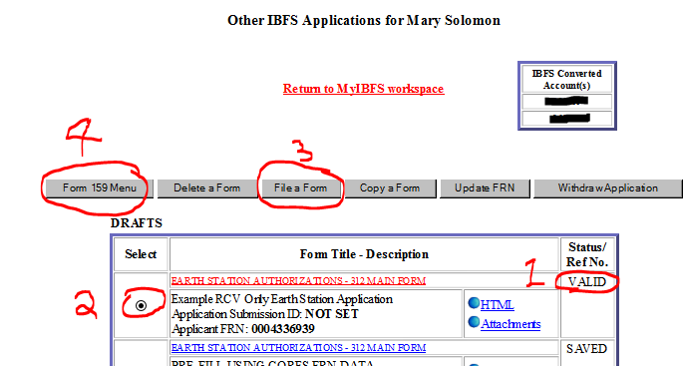
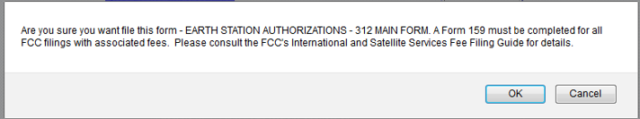
How to submit your application for processing.
Ensure your draft is VALID
Select the Radio Button on the left
File a Form
When you “File A Form”, you will be asked to confirm your request and you will receive a confirmation screen when successfully submitted.
Return to the Main Menu for Step 4 – Form 159 Menu, if a fee is required.

Slide 31
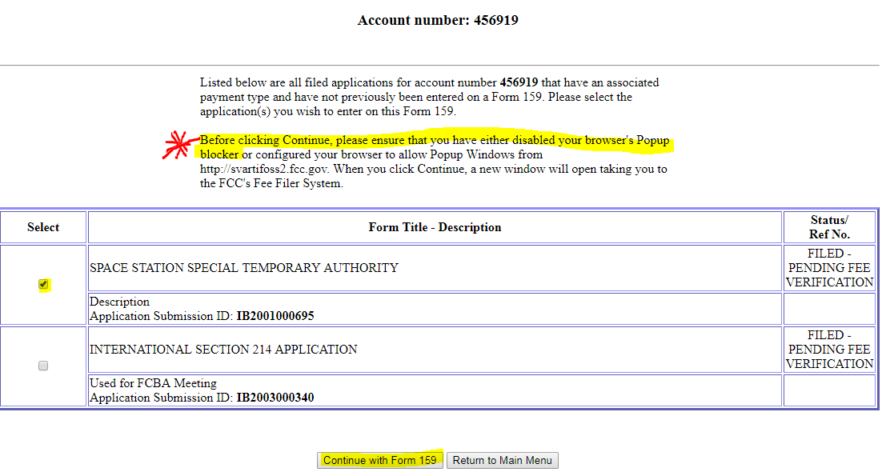
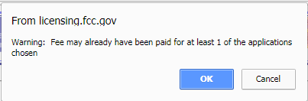
Form 159 Menu Screens
Select the application
Be sure your popup blocker is OFF/popups are allowed
Continue with Form 159
Click Ok on the warning message

Slide 32
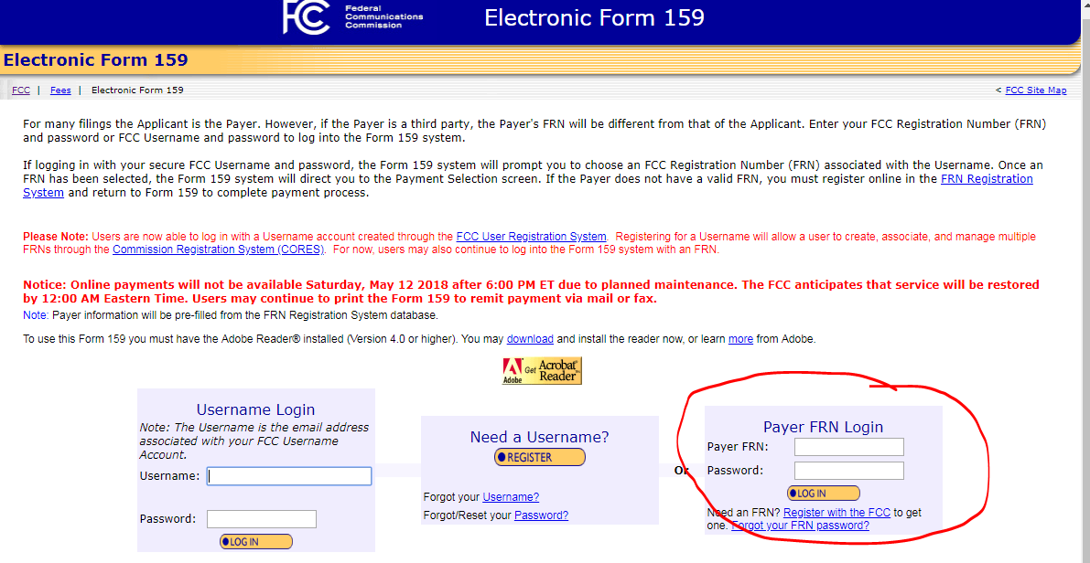
Electronic Form 159 page will open, often UNDER your current window.
Log in and continue through the Fee Filer screens.
You will have an opportunity to save/print your Form 159 for your records before returning to MyIBFS.

Slide 33
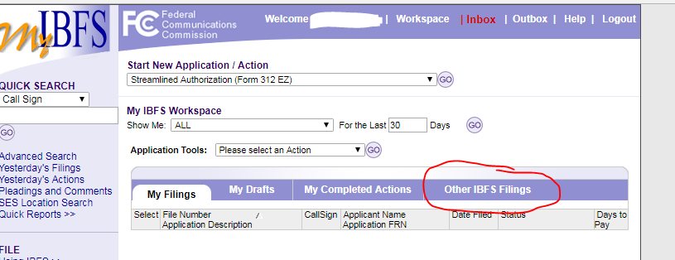
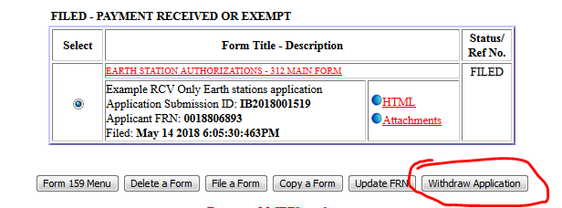
If you need to withdraw the application, go to Other IBFS Filings
Select the radio button to the left of the application
Click the “Withdraw Application” button

Slide 34
Review:
To register an earth station at one location consisting of one antenna: File one Form 312, one Schedule B , one Site ID and one Antenna ID.
To register an earth station at one location consisting of multiple antennas: File one Form 312, one Schedule B, one Site ID and two or more Antenna IDs.

Slide 35
Freeze and Filing Window Q&A (1/2)
On May 14, 2018, the Commission released a Q&A on the freeze and filing window. The following are responses to additional questions that we have received since then.
Can I file one earth station application for multiple antennas if they are all located at the same site?
  Yes, applicants may include all receive antennas located at the same geographic location under the same earth station application. Each antenna and its associated characteristics should be identified on the Form 312 Schedule B.
What if I have a modification that isn’t identified as an exception to the freeze?
  Applicants who seek a modification to existing earth station authorizations (other than a modification to correct inaccurate technical data in the file) should request a waiver of the freeze as part of their applications. The request should include a brief narrative justification explaining the nature and scope of the waiver request, explain how public interest will be served by the waiver, and explain how the purpose of the freeze will not be undermined by grant of the waiver.

Slide 36
Freeze and Filing Window Q&A (2/2)
My earth station is old and I can’t find the manufacturer and/or model number. How can I provide the technical characteristics?
  Earth station operators should make every effort to provide the specific technical characteristics of their antenna when filing an application. However, where such information is unavailable, earth station operators may provide the frequency band and antenna size.

