Slide 1
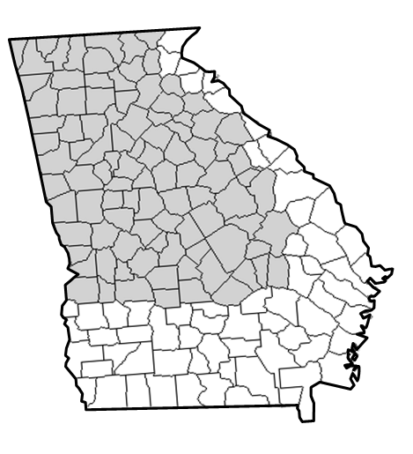

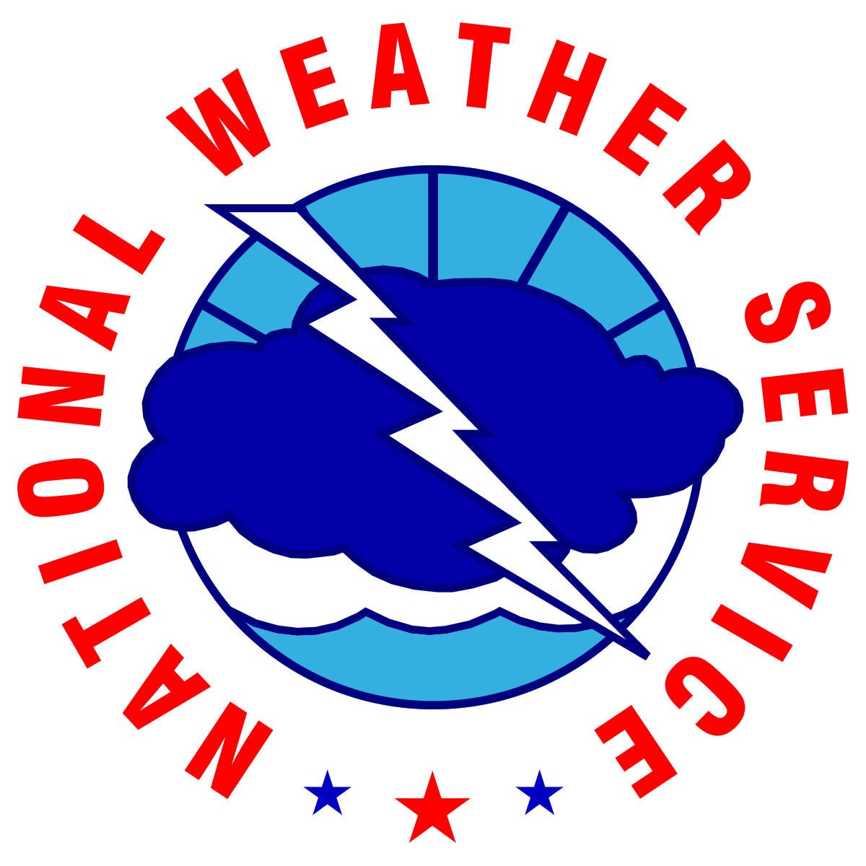


Weekly Weather Briefing
Provided by:
NWS Atlanta/Peachtree City
For the Week Starting
September 18, 2025
Disclaimer: The information contained in this briefing is time sensitive and this should be taken into consideration while viewing.
‹#›
NATIONAL WEATHER SERVICE ATLANTA
weather.gov/Atlanta
Follow:
@NWSAtlanta
Updated: Thu Sep 18, 2025 11:24 AM

Slide 2

Hazard Outlook for North & Central Georgia
Risk Levels → |  | Low | Moderate | High | Extreme
Sunday
v
Friday (9/5)
Saturday
Monday
Tuesday
Wednesday
Thursday
Isolated thunderstorms in northeast GA
(2PM to 10PM)
Isolated thunderstorms in NE GA/metro (2-10PM)
Mostly dry and warm
Isolated thunderstorms in south-central GA
Scattered afternoon to early evening thunderstorms
Scattered afternoon to early evening thunderstorms
Scattered afternoon to early evening thunderstorms
Isolated rain and thunderstorm chances linger through the weekend with a slightly greater opportunity for rain and thunderstorms closer to mid-week next week.
Warm, above normal temperatures are forecast to continue over the next 7 days.
Weather
Highlights
‹#›
NATIONAL WEATHER SERVICE ATLANTA
weather.gov/Atlanta
Follow:
@NWSAtlanta
Updated: Thu Sep 18, 2025 11:24 AM

Slide 3
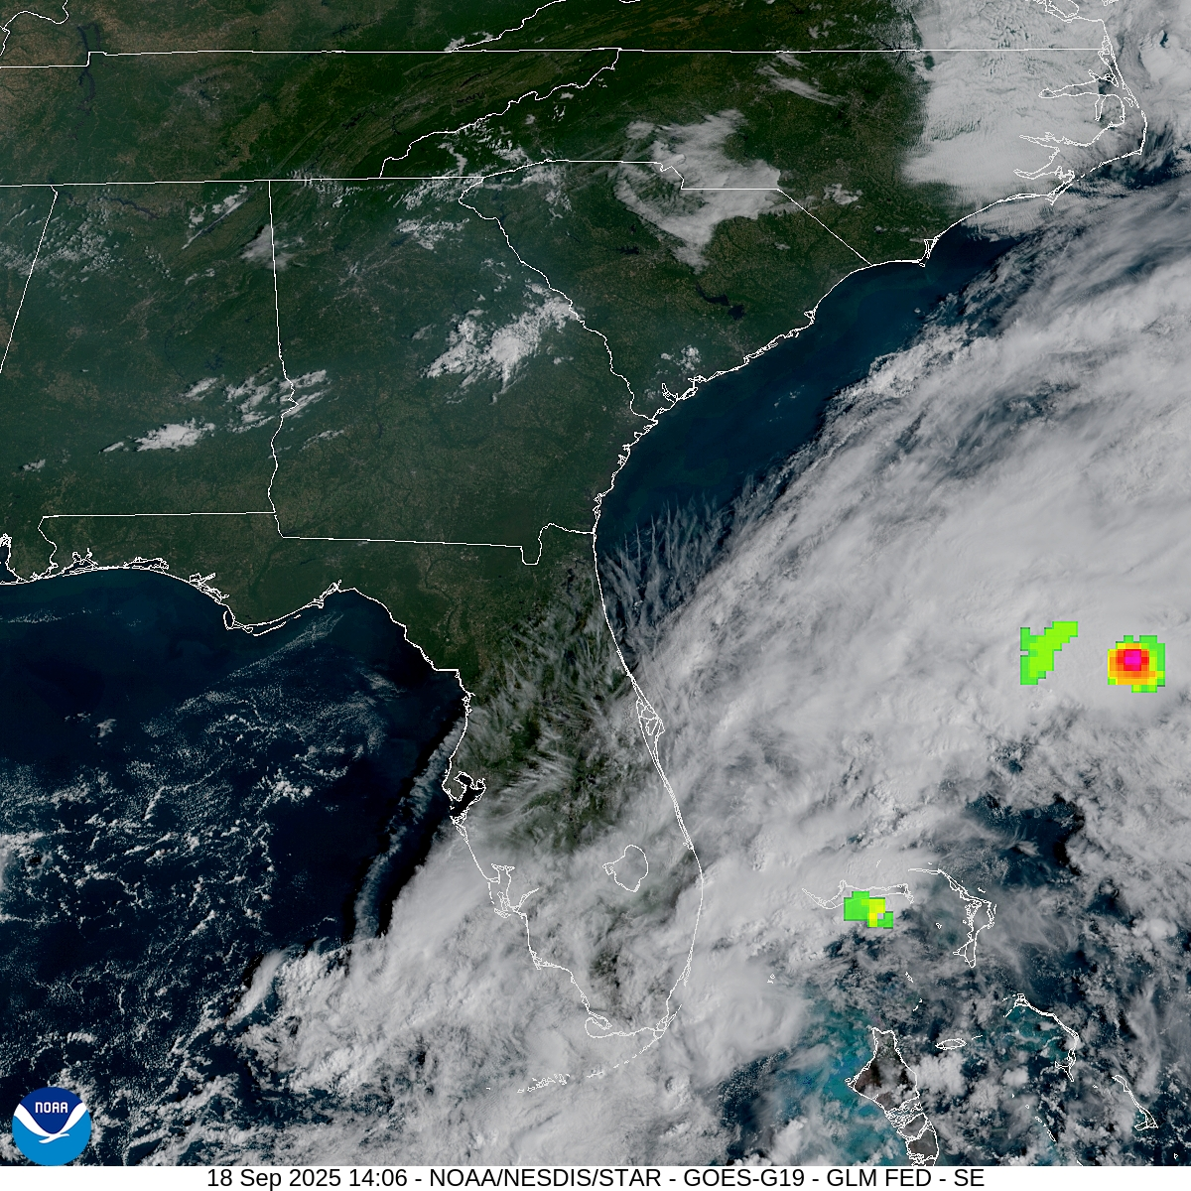
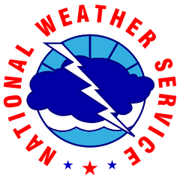
Latest Satellite / Weather Pattern
Weather Highlights
Slightly warmer temperatures this afternoon; upper 80s to low 90s.
Isolated showers and storms possible between 2-10PM today.
NATIONAL WEATHER SERVICE ATLANTA
Follow:
@NWSAtlanta
‹#›
Updated:
September 18, 2025

Slide 4
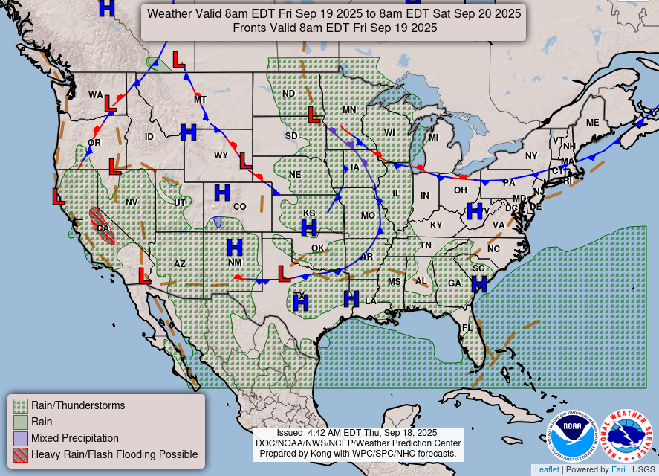
Weather Map/Pattern: Tonight & Tomorrow (Fri.)
Projected Surface Weather Map
Weather Highlights
Surface high pressure will continue to promote warm conditions through Friday.
Isolated showers and storms remain a possibility on Friday afternoon.
NATIONAL WEATHER SERVICE ATLANTA
Follow:
@NWSAtlanta
‹#›
Updated:
September 18, 2025

Slide 5
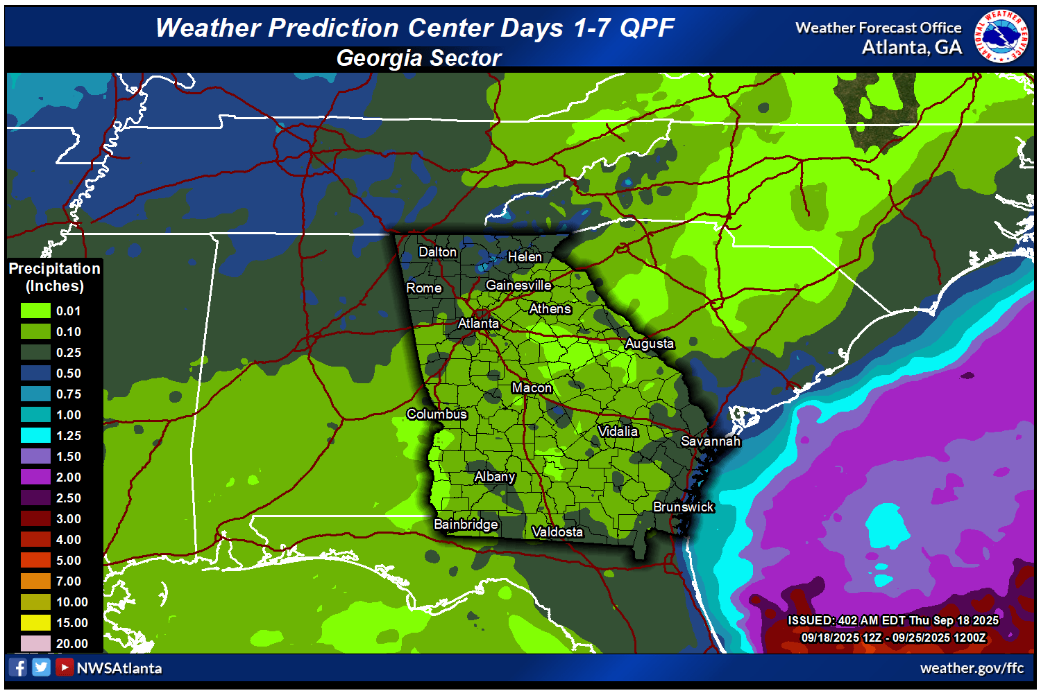
Potential Rainfall (through Thursday 9/25)
7-day Total Rainfall Prediction
General Rainfall through Thursday (9/25)
Limited rainfall overall (<0.25”), though isolated pockets up to 0.5” are possible in far North GA.
NOTE: this does NOT capture areas of heavier rain that could occur with any thunderstorms.
NATIONAL WEATHER SERVICE ATLANTA
Follow:
@NWSAtlanta
‹#›
Updated:
September 18, 2025

Slide 6
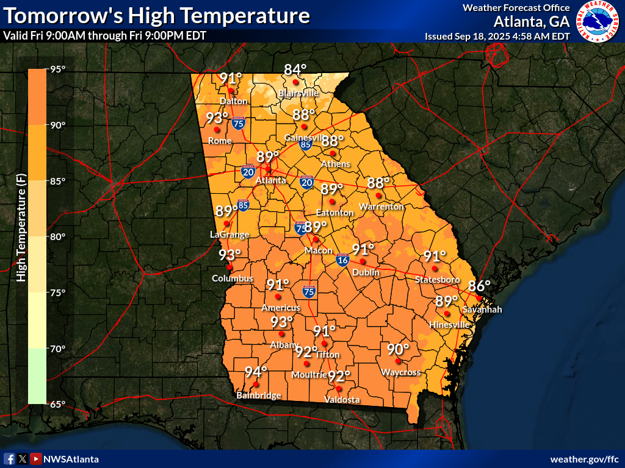
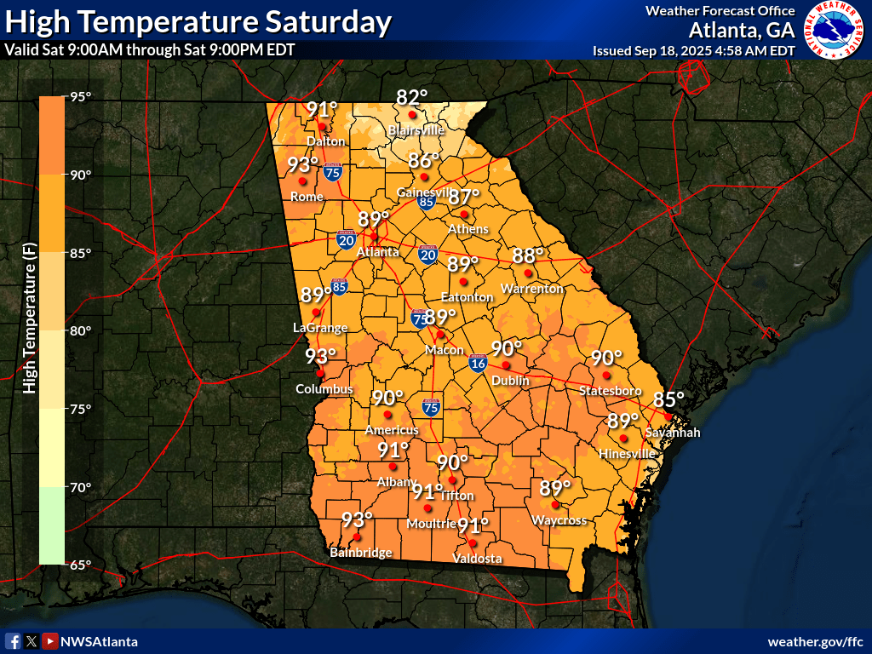
High Temperatures: Friday and Saturday
‹#›
NATIONAL WEATHER SERVICE ATLANTA
weather.gov/Atlanta
Follow:
@NWSAtlanta
Updated: Thu Sep 18, 2025 11:24 AM

Slide 7

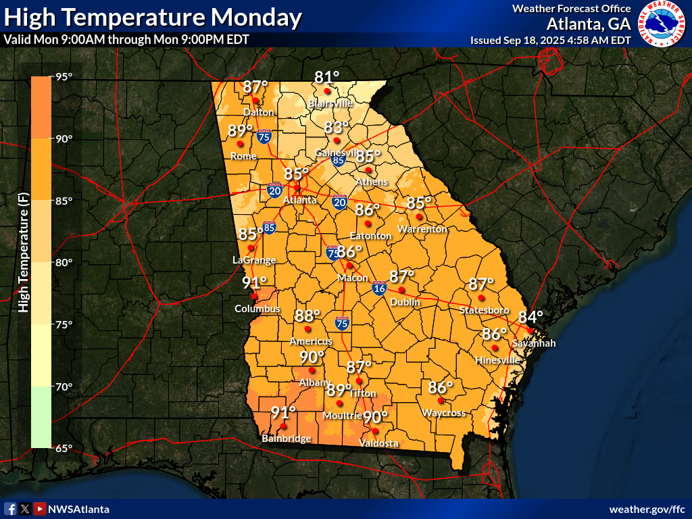
High Temperatures: Sunday and Monday
‹#›
NATIONAL WEATHER SERVICE ATLANTA
weather.gov/Atlanta
Follow:
@NWSAtlanta
Updated: Thu Sep 18, 2025 11:24 AM

Slide 8
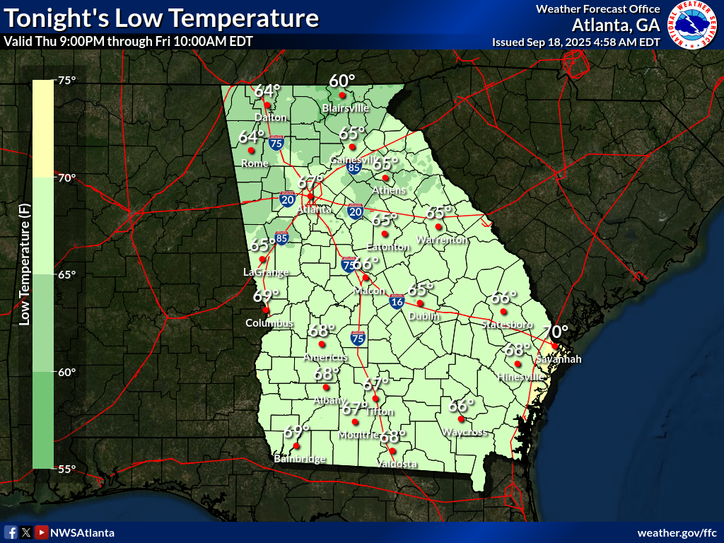
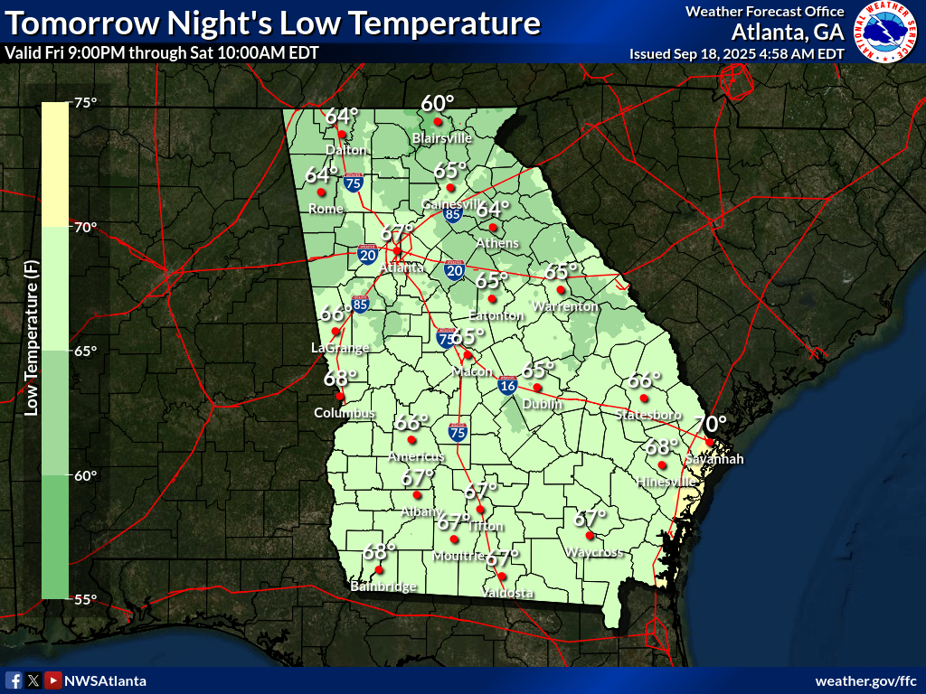
Low Temperatures: Tonight and Tomorrow Night
‹#›
NATIONAL WEATHER SERVICE ATLANTA
weather.gov/Atlanta
Follow:
@NWSAtlanta
Updated: Thu Sep 18, 2025 11:24 AM

Slide 9
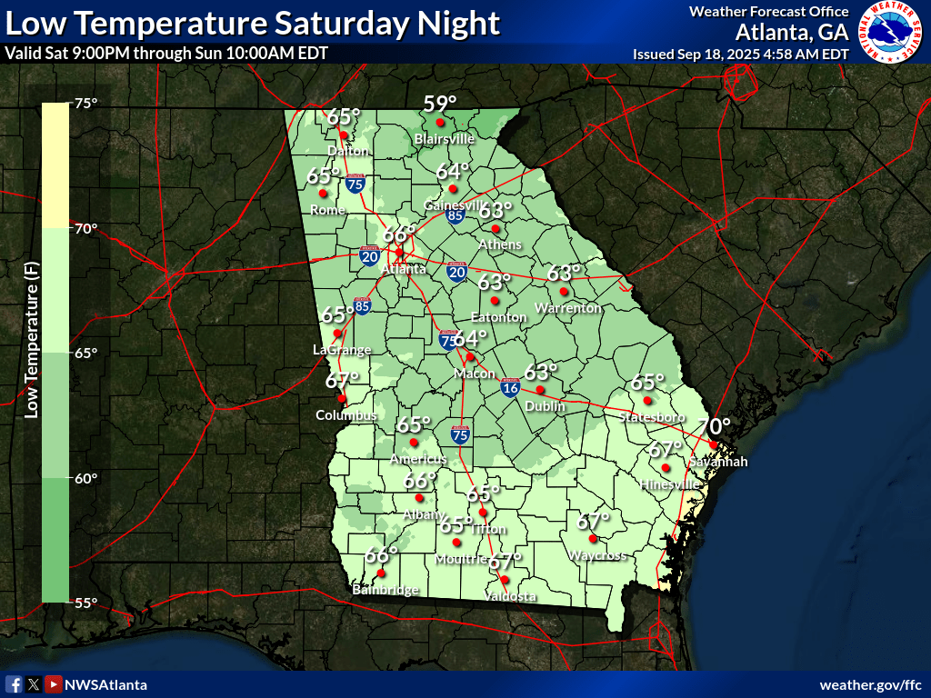
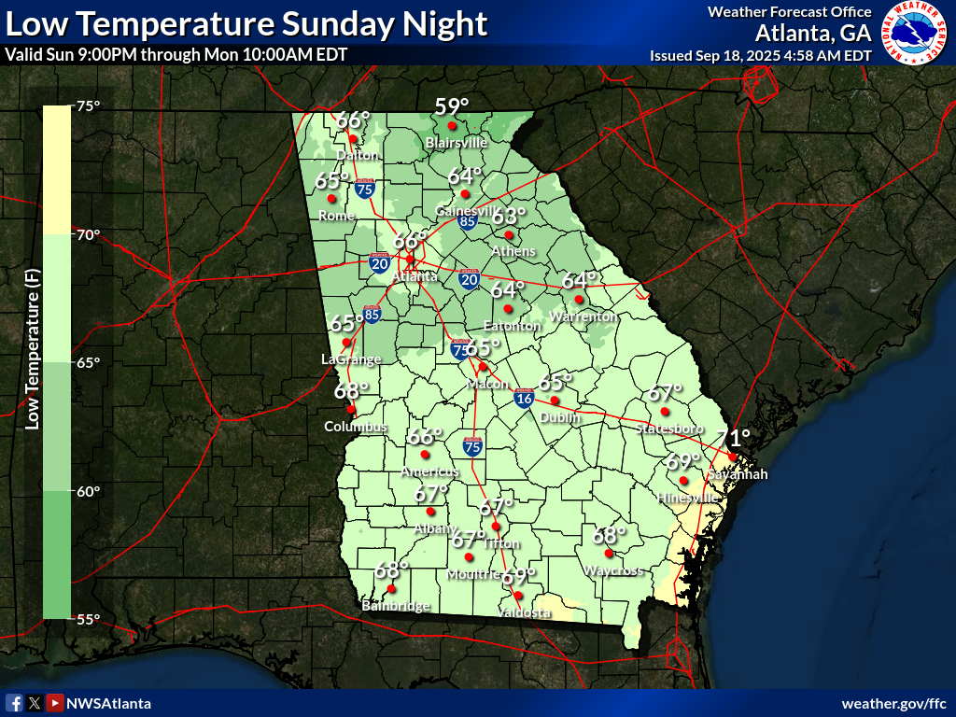
Low Temperatures: Saturday Night and Sunday Night
‹#›
NATIONAL WEATHER SERVICE ATLANTA
weather.gov/Atlanta
Follow:
@NWSAtlanta
Updated: Thu Sep 18, 2025 11:24 AM

Slide 10
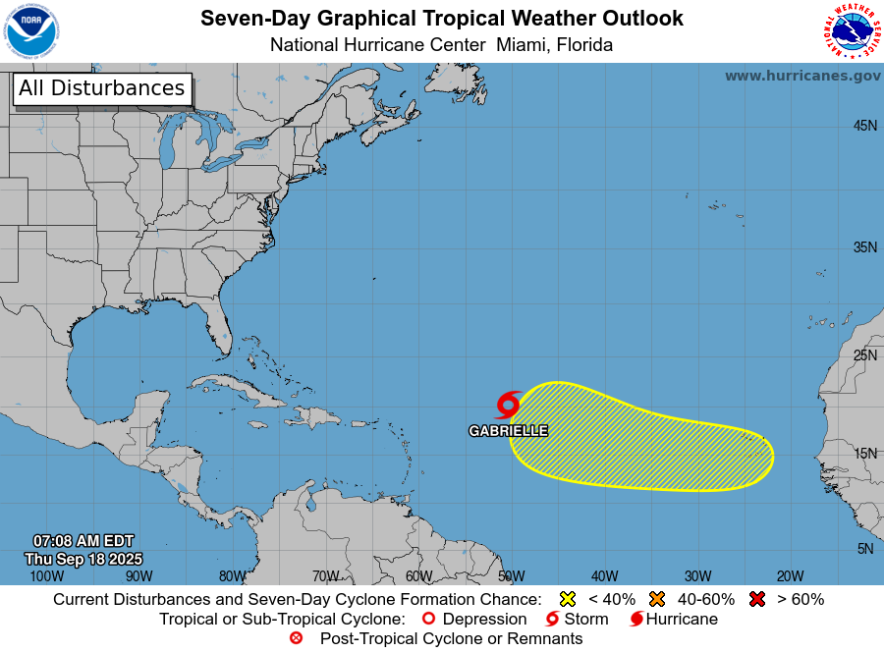
Tropical Update (Sept 18th-24th)
No Impacts for next 7 days
Tropical Storm Gabrielle is expected to curve out to sea, well away from the United States
Next tropical disturbance has a 20% chance to form over next 7 days, but remains well away from any land
No impacts to north and central Georgia expected over the next 7 days
NATIONAL WEATHER SERVICE ATLANTA
Follow:
@NWSAtlanta
‹#›
Updated:
September 18, 2025

Slide 11
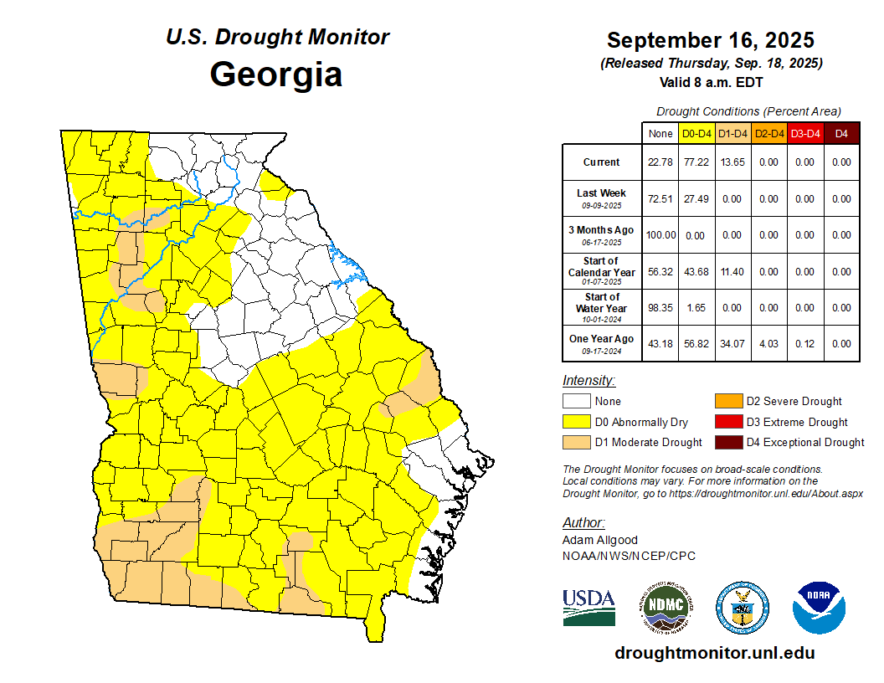
Drought Update
Official drought conditions (D1) have been introduced today in parts of west Georgia
Rainfall is < 15% of average in many of these areas over past 30 days
Monitoring for potential “flash drought” conditions
‹#›
NATIONAL WEATHER SERVICE ATLANTA
weather.gov/Atlanta
Follow:
@NWSAtlanta
Updated: Thu Sep 18, 2025 11:24 AM

Slide 12
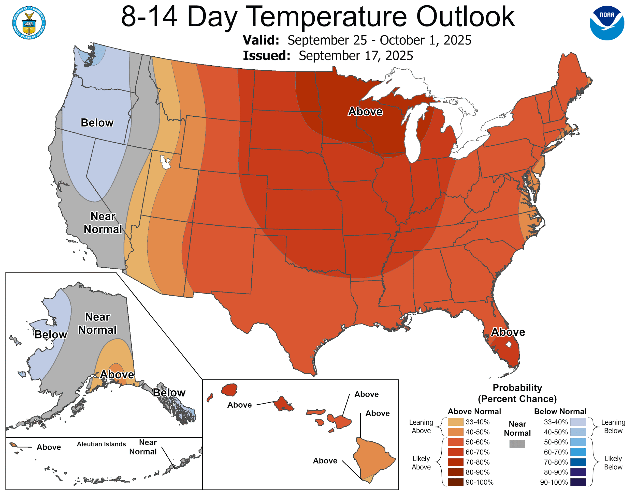
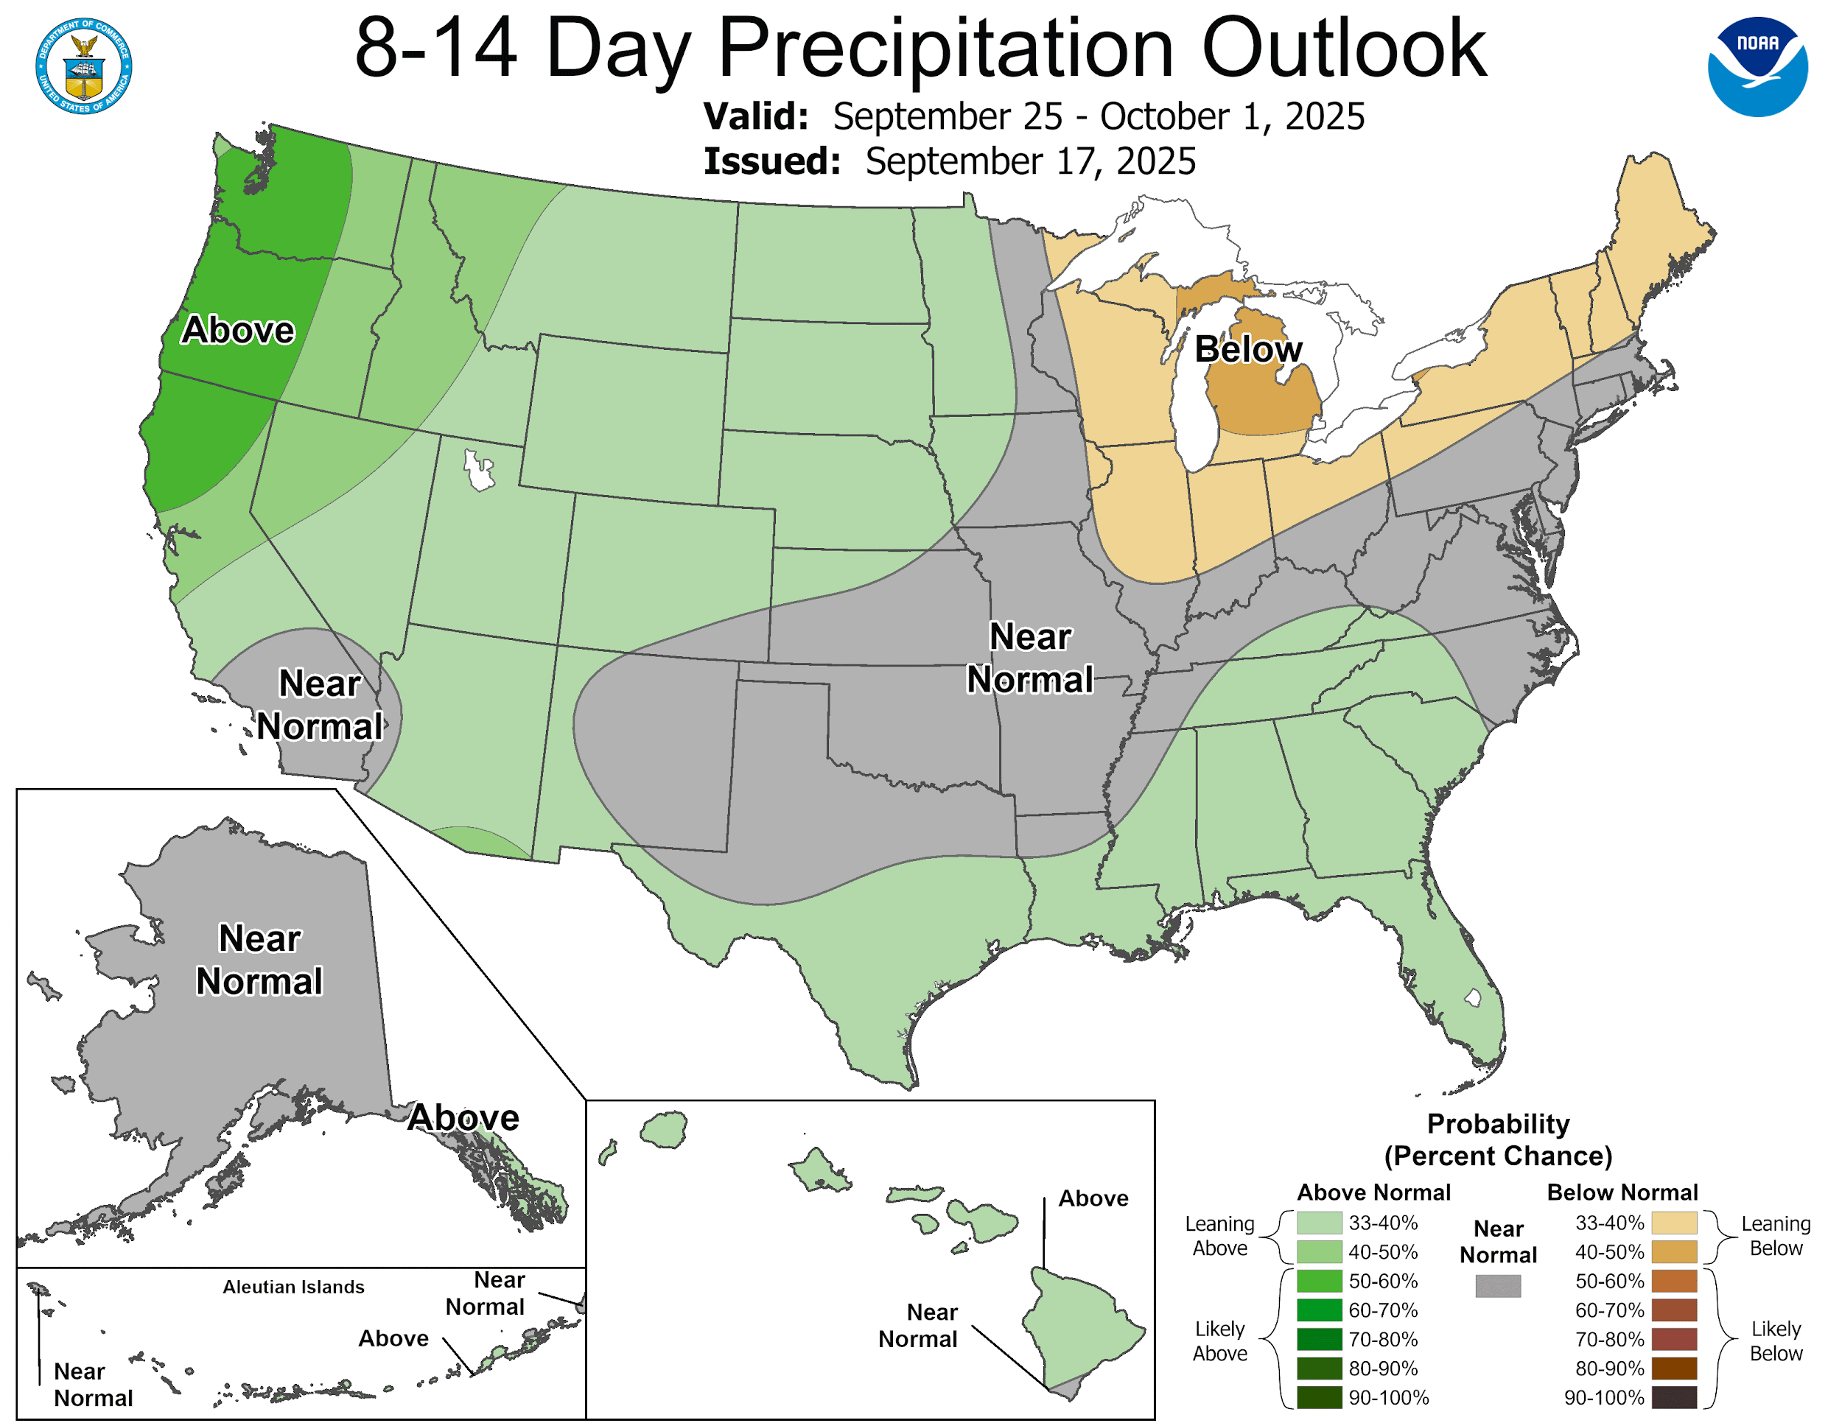
September 25th-October 1st Outlook
‹#›
NATIONAL WEATHER SERVICE ATLANTA
weather.gov/Atlanta
Follow:
@NWSAtlanta
Updated: Thu Sep 18, 2025 11:24 AM

Slide 13

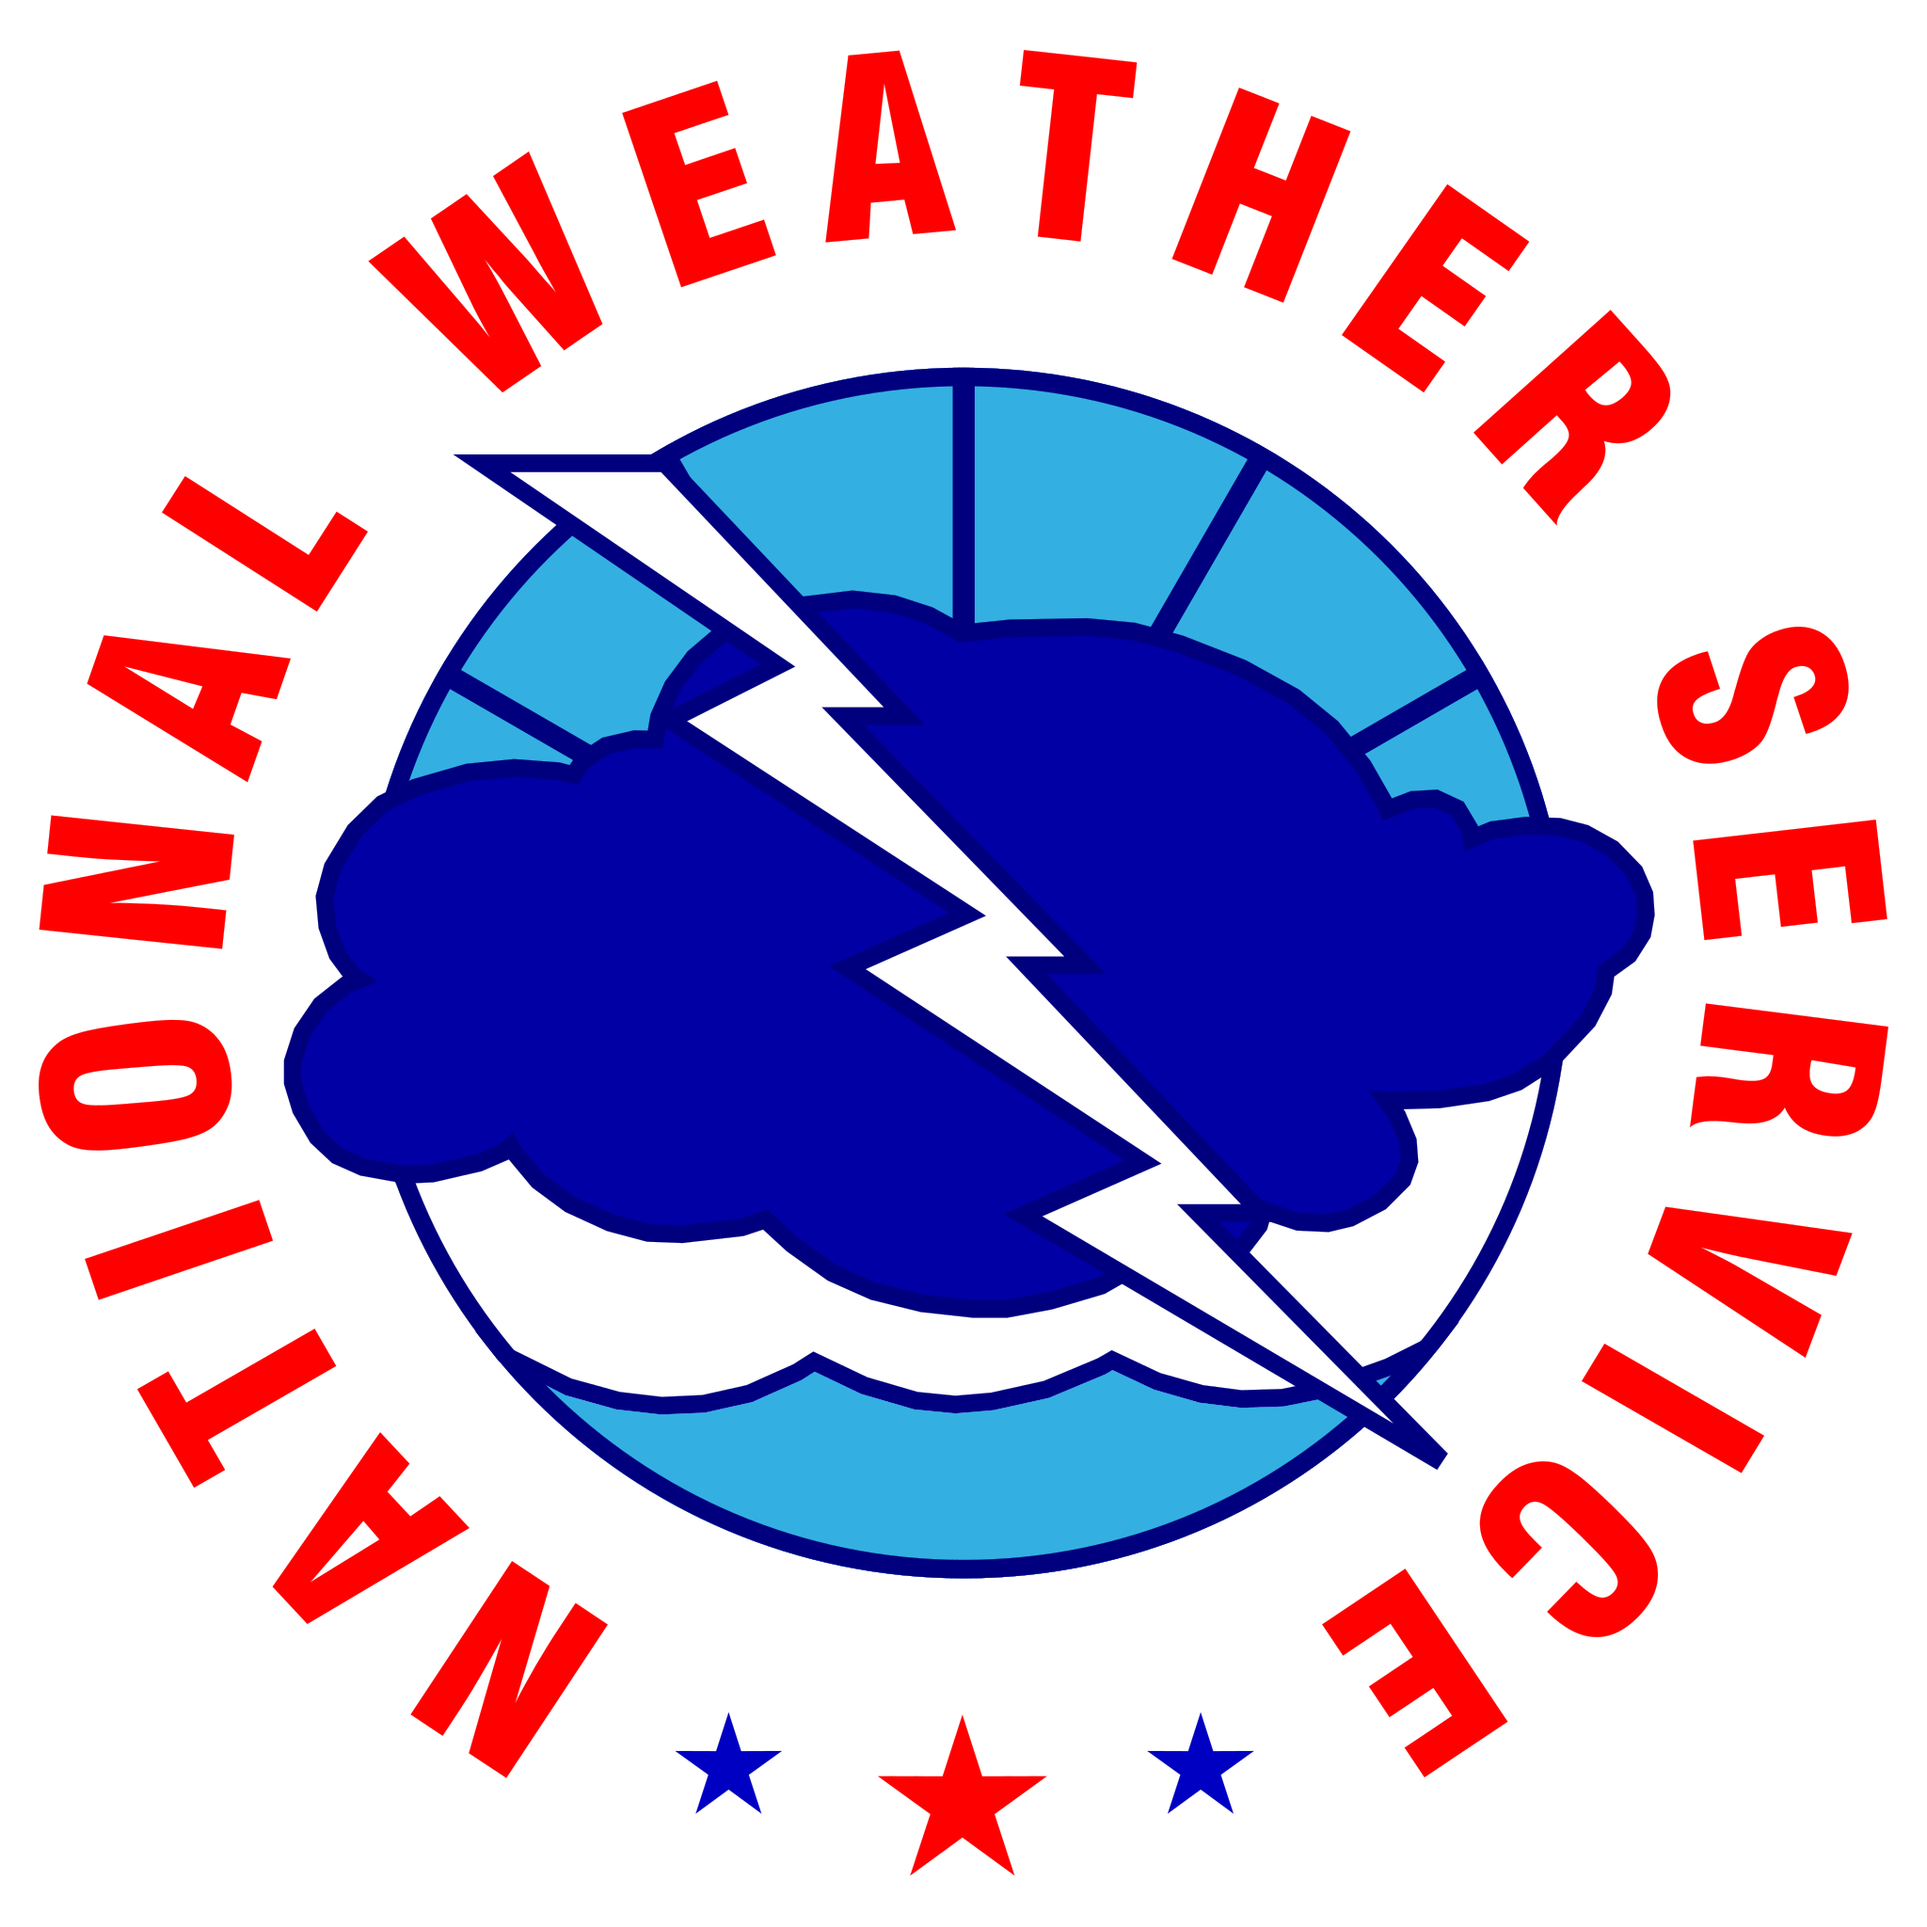









Contact Information
September 18, 2025
11:24 AM
By Phone
770-486-1133
Twitter
@NWSAtlanta
Via Email
sr-ffc.webmaster@noaa.gov
Instagram
nwsatlanta
Online
weather.gov/atlanta
weather.gov/ffc/briefings
Facebook
NWSAtlanta
NWS Chat
EMs, Media, and approved partners
YouTube
@NWSPeachtreeCity
Decision Support
weather.gov/ffc/dss
National Weather Service
National Weather Service
Peachtree City, GA

