Slide 1
Snow Paid Guidance
Pre-season guide to preparing the snow paid program
Before snow begins to fall, snow paid personnel must be ready to observe the elements. In order to avoid any unnecessary delays in payment, all paperwork must be done as early as possible. Paid stations can operate from October through March.
As of 2018, the NWSREP must have the observer fill out the NOAA form 36-14 and the CBS Individual Payment Profile form. The NWSREP then sends the information on to the region COOP Program Manager.
Each month throughout the season, the NWSREP records the number of observations taken, records them on a B-86 form, and emails them to Eastern Region.

Slide 2
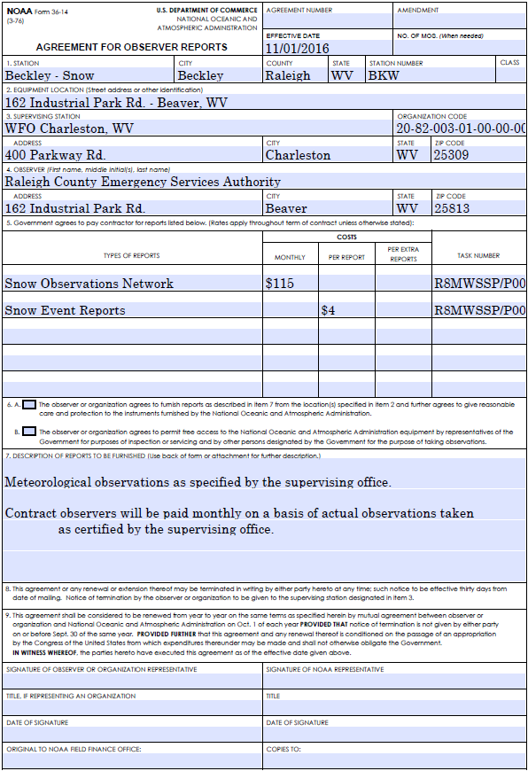
NOAA form 36-14
-This form contains site location information, payment information, and the description of duties to be performed by the observer.
-Snow paid observers are paid on both a monthly basis and a per-observation basis.
-All Financial codes will be provided by your Region COOP Program Manager.
-This form can be found at www.nws.noaa.gov/om/forms/

Slide 3
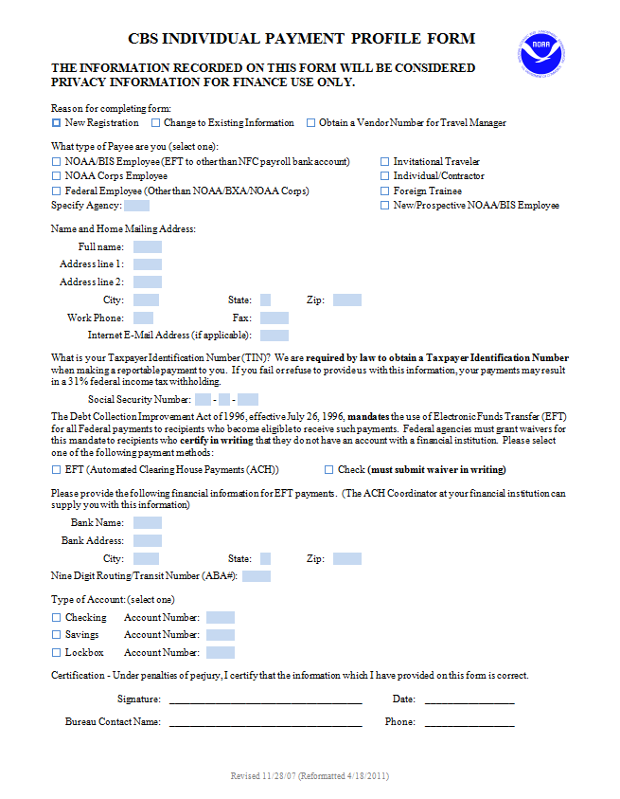
CBS Individual Payment Profile Form
-This form contains the specific payment information of the observer and is used by the finance office.
- Each season “New Registration” and “Individual/Contractor” must be selected.
-This form contains PII and must be kept in a secure location.
- This form can be found at www.corporateservices.noaa.gov/finance/indivpayform.html

Slide 4
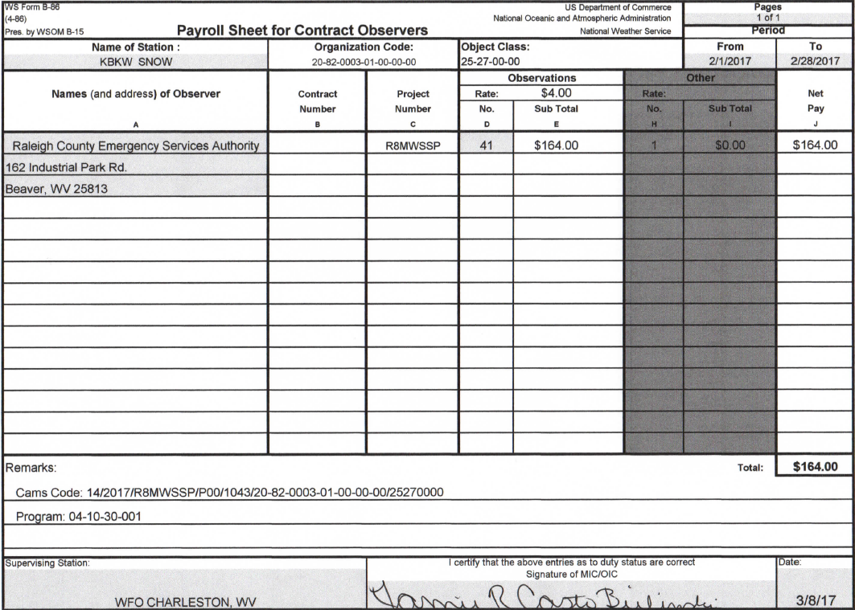
B-86 Form
-This form tracks the number of observations taken each month as well as containing financial information for region.
- It is to be filled out, signed by the MIC, and sent to easternoperations@noaa.gov each month.

